Slide 1
Social Media Best Practices (Engagement)

Slide 2
Background
Eli Burris
Social Media & Content Marketing Manager
Degree: Journalism – Strategic Communication, Ohio University
Past Roles:
Communications at OHSAA
www.linkedin.com/in/eliburris/
Elise Holbrook
Senior Social Media Specialist
Degree: B.S. Communication (Public Relations Focus), Western Carolina University
Past Roles:
Web Content Manager, Westminster College
Social Media Coordinator, Western Carolina University
www.linkedin.com/in/elise-holbrook

Slide 3
Responsibilities
Manage flagship Ohio University social media accounts
Organic content generation
In collaboration with UCM photo, video & news teams
In support of recruitment, retention and university initiatives and priorities
Support crisis communications
Social listening
Track/report performance
Manage engagement
Social media advertising support (Marketing & Ad Strategy Team)
Consulting (campus departments/organizations)
@officialohiouniversity
@ohio.university
@ohiou
Ohio University
Ohio University

Slide 4
Before Content Planning, Identify...
Who is your target audience(s)? What platforms are relevant for those audiences?
Primary OHIO Channels:
Facebook: Alumni, parents/guardians/family members, OHIO employees, and some current and prospective students
LinkedIn: Alumni, OHIO employees, parents/guardians/family members, and some current students
TikTok: Current & prospective students
Instagram: Current & prospective students, alumni, and some parents/guardians/family members
Twitter: Current & prospective students, alumni, OHIO employees, and some parents/guardians/family members
What is your purpose on each platform? Does it align with the purpose of the platform?
Instagram: Photo- and video-based (visual) content, no links in feed, older & younger users
LinkedIn: Variety of content types, more professionally focused
Facebook: Variety of content types but hashtags/searches feel less of a part of the platform, typically older audience
Twitter: Hashtags/keywords can help reach niche audiences, audience skewing younger, opportunities to chime in on time-relevant (trending) topics, small character count
TikTok: Video-based content, lots of opportunity to make content in a niche, a lot of Gen Z but still has users/creators across ages, surpassed Google as most popular website, no links in feed

Slide 5
Before Content Planning, Identify...
Quality over quantity – sometimes less is more
The capacity you have for posting, monitoring & engaging
The goals you have & when/how you will evaluate reaching them (what does "success" mean to you?)
The personality/style/tone you want
The topics/trends/popular content in your niche
The content resources you have (OHIO News, Photoshelter, student content creators, etc.)
Eli's Photo Folder
Learn more about demographics: Social media demographics to inform your brand’s strategy in 2022

Slide 6
Basics
Building an engaged following takes a long time of being consistently active in a meaningful way with quality content
Understand the purpose of your post when crafting it
Explore all your options for content types within the platforms you use
Explore what other campus social channels can share your content and help you build followers
Visuals grab attention — use quality photos
Use keywords, key phrases, and hashtags to optimize posts for in-platform searching
People tend to not watch super long videos in their entirety if they aren’t compelled to

Slide 7
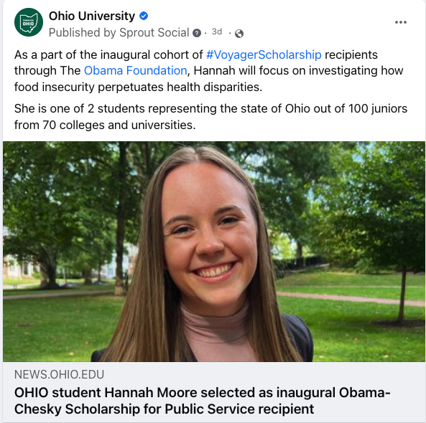
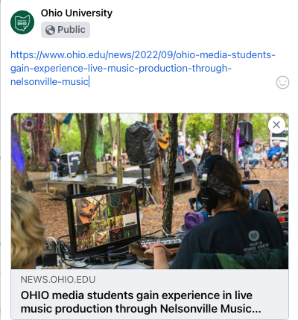
Basics
Keep copy simple and easy to read
Tag other accounts when relevant, but try to work it into the copy
When sharing links on Facebook & LinkedIn, you can put the link in the post, wait for the link card to populate, then remove the link from text. Twitter WILL NOT do this.
Make your account look professional, have a good photo, banner (if applicable), and bio
Follow & interact with content that is similar/relevant to your own
If you have a website, link your social channels on it

Slide 8
Tools
Scheduling tools – in platform & external (Sprout, Hootsuite, etc.)
Graphic design tools (Canva, Adobe Express, etc.)
Video editing tools (CapCut, iMovie, Adobe Premiere, etc.)

Slide 9
Popular Content
Popular content:
Campus beauty photo/video
Athletics
City of Athens
Trending content
UGC
Student experience/student life

