Slide 1
Climate Survey Results
April 2020 Wednesday Workshop

Slide 2
The Survey
Notes:
Campus climate as a metaphor originated with Hurtado’s 1990 dissertation looking at college learning environments. Hurtado’s original definition for ‘campus climate’ was as a way to look at racial tension and institutional commitment to diversity
Climate is in the interpersonal interactions

Slide 3
About the Survey
Survey was designed based on research and existing instruments measuring same or similar topics in and outside of higher education
Some research suggests that instead of ‘climate’ we should instead discuss the art of living together, tension, and how we get along-– instead of objectifying underrepresented groups
Notes:
Maybe, the authors suggest, moving forward we should talk about the art of living together instead of climate; discuss the tension and how do we get along and interact instead of objectifying underrepresented groups

Slide 4
A group of four ESJ committee members worked for 8 months to scan best and existing practices, look at other instruments, build questions, seek feedback, and pitch the final instrument
Survey was reviewed by Tony Orange, ESJ committee, Dean of Students, VPSA and the Chief of Staff prior to distribution
The survey was built into Qualtrics and invitations were sent to all DOSA employees
The survey was open for 3 weeks to collect data
Notes:
The survey was built into Qualtrics. Survey invitations were distributed via divisional listserve messages. Over a three-week period towards the end of fall 2019, email invitations were sent to all (a) professional, (b) bargaining, and (c) graduate assistant

Slide 5
Respondent Profiles
Notes:
Katie

Slide 6
Who took the survey? Department size
Notes:
About 160 people took the survey, you’ll see some variability around that as people sometimes skip items and do drop off as they get further into the survey

Slide 7
Who took the survey? I identify as…

Slide 8
Who took the survey? I identify as

Slide 9
Who took the survey? Years of Service

Slide 10
Race/ethnicity (select all that apply)

Slide 11
In-Service

Slide 12
For the Equity and Social Justice in-service requirement, how would you like to learn? Select all that apply

Slide 13
For the Equity and Social Justice in-service requirement, how would you like to learn? Select all that apply

Slide 14
Current Understanding of ESJ
Notes:
Jenny

Slide 15
I understand what ESJ looks like in the core functions of my job

Slide 16
Examples
Theme | #
Treat everyone with respect and equal | 10
Acknowledge and remove barriers of bias in office | 9
Make safe and accessible welcoming spaces | 9
Provide resources | 9
Use inclusive language accept preferred pronouns | 9
Listen | 7
Promote inclusive involvement/training and new events | 7
Staff who agreed or strongly agreed were asked to provide an example of how they identify and remove barriers for students.
There were 117 write in responses
The emergent themes were:

Slide 17
I help others learn about concepts related to equity and social justice through my work.

Slide 18
Examples of helping others learn concepts of ESJ through work
Share how you help others learn concepts related to equity and social justice through our work: | Number
Frame trainings around job duties | 11
Open discussions - incorporate informative dialog | 11
Conversation around privilege, biases | 9
Casual conversations | 8
Reflection and open discussion - ongoing | 6
Of those who agreed or strongly agreed, they were asked the follow-up question
102 responded
These are the most emergent themes in their responses:

Slide 19
I cultivate inclusive community through my work
Those who ‘agree’ or ‘strongly agree’ received a prompt to share an example. There were 99 write-in responses
Share an example | counts
Welcoming environments - include visible markers safe space and accessible | 11
Open judgement free conversations for everyone - discussions | 11
Promote equity and inclusion -encourage respect | 6
Use inclusive language to signal that everyone is welcome - self-awareness when using language | 6
Be accepting | 6

Slide 20
Reflect and Discuss
Prompts
Reflect → discuss in chat using the question # → group discussion
As supervisors, how do these data points strike you?
Reflect on ESJ work pre- and post- COVID-19.
How could we be doing more of this work in our day- to-day work?
Use the chat!

Slide 21
Share your ESJ goal
 | Knowledge Acquisition
16 | Action-based
5 | Both knowledge and action
16 | Neither knowledge nor action
14 | Unclear
Within knowledge acquisition, the specific areas were:
Increasing knowledge on Accessibility Systems, Services, and Accommodations
Increase knowledge of LGBTQ+ Community
Increase knowledge of Equity and Social Justice through events

Slide 22
Sense of Belonging and Connectedness

Slide 23
Do you feel a sense of belonging and connectedness within DOSA?
Notes:
45% no
55% yes

Slide 24
Do you feel a sense of belonging and Connectedness within Ohio University?

Slide 25
Do you feel a sense of belonging and connectedness within your department?

Slide 26
I am comfortable sharing my reflections and processing information with… (select all)

Slide 27
Connection to Research
We’ve focused on sense of belonging as one aspect of engagement and connection to place
Gallup does research on employee engagement
Citing 50 years of research, they argue that engaged employees produce better outcomes than other employees– across industry, company size and place, and in good and bad economic times
Their research says only 15% of employees and 35% of U.S. employees are engaged
Notes:
Link to Gallup article:
https://www.gallup.com/workplace/285674/improve-employee-engagement-workplace.aspx

Slide 28
What Helps People Feel Connected?
In the message sent out Monday, I asked you to think about:
As a leader, how do you facilitate a sense of belonging and connectedness for others?
What helps you feel connected?
Share your thoughts in the chat!
Use the chat!

Slide 29
Goals & Recognition

Slide 30
Appreciation

Slide 31
How often do you recognize others for a job well done?
Notes:
Now,

Slide 32
Have you talked about your PD with your supervisor at least 3x in 2019?
Why is this not happening?
What do you need to happen for these to happen more?
Have you filled out the PD form for 2020?
Have you talked about your PD with your supervisor at least 1x in 2020?

Slide 33
Reflection and Discussion
Prompts
Reflect → discuss in chat using the question # → group discussion
Were you involved with the development of your dept’s ESJ goal?
Were you involved in the achievement of your dept’s ESJ goal?
Did you use DAP to help set a personal ESJ goal?
My supervisor supports my development on ESJ topics related to my job
Use the chat!

Slide 34
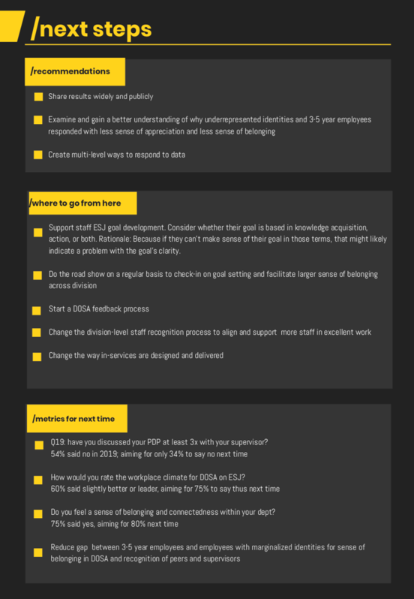
What do we plan to do?
The last page of the executive summary outlines action items and specific survey questions we want to do better on when the survey is repeated
A lot of the responses to this data will come from the ESJ Committee
But… we made this WW so that you too can respond to it too

Slide 35
Notes:
And, turn it over to Megan for any questions…

