Slide 1
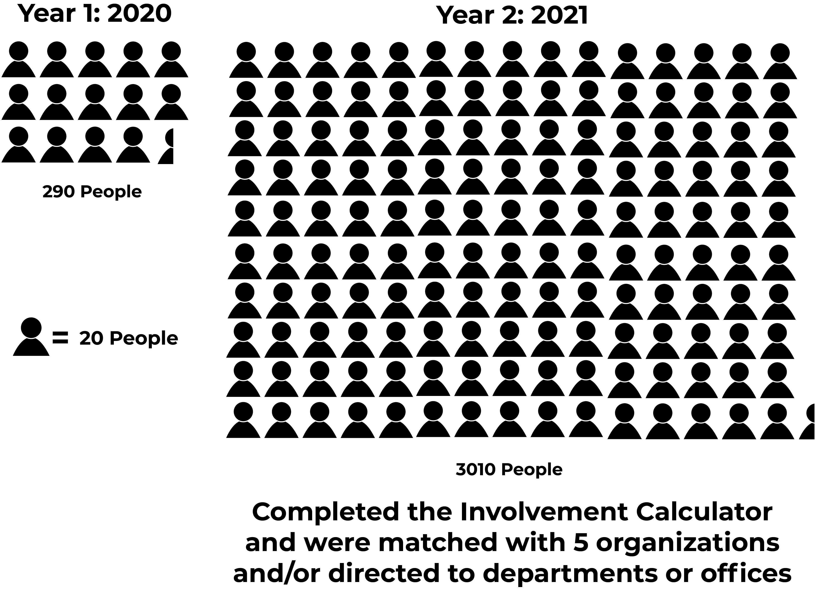
Campus Involvement Center: The Involvement Calculator
LEARNING GOAL
WELL-BEING: SENSE OF BELONGING: Students will be able to develop/experience a sense of belonging to a greater community through engaging in social activities that are reflective of one's values and sense of purpose.
ANALYSIS OF INSTRUMENTS AND PROCESS
Same descriptive terms were used on the IC and the student organization registration form. This provided a more comprehensive flow that matched the student organization descriptors with student interests.
Process: The Involvement Calculator was introduced during Bobcat Student Orientation. The orientation leaders had first year students complete the IC as part of Bobcat Student Orientation.
RESULTS
The results of the Involvement Calculator are reviewed and each student receives personalized report identifying up to five student organizations that match the student’s interest. The personalized report also invites the student to schedule an involvement consultation with a CIC staff person should that want more information on involvement at Ohio U.
.
.
Process: Having the IC utilized as a suggested activity in the UC Learning Community class did not produce the yield anticipated. Only 290 first year students completed the IC.
Due to the lack of specificity of the IC survey questions and student organization registration form it was felt that there was too much subjectivity on the matching of interest process.
Instruments: The Involvement Calculator survey questions were not specific enough. This made it difficult to match student interests with student organizations. The student organization registration form did not provide specific enough information to allow for adequate matching to student interests.
IMPLICTIONS & CHANGES
Spring 2021
Instruments: Based upon our assessment of the Involvement Calculator and student organization registration form both were modified.
NEED/PROBLEM
With the onset of the Covid pandemic, the CIC had to develop a replacement for the traditional in person Involvement Fair. Taking place opening weekend, the Involvement Fair was a great opportunity for first year students to connect with student organizations of their interest and begin to establish a sense of belonging.
INTRODUCTION: Summer 2020, the CIC created the involvement calculator to virtually take the place of the Involvement Fair. The Involvement Calculator (IC) is a tool to help students find and foster a stronger sense of belonging on campus. (IC) is a short inventory for students to take that focuses on identifying organizations that complement the student’s academic and social interest.
TIMELINE
TEAM MEMBERS
Josh Gruenke
Char Kopchick
2020-2021

