Slide 1
Disability Access in Health Science Education
Adam Crawford
Assistant director, The Ohio state university
Envision access conference, march 2021

Slide 2
Agenda
Review four areas of focus in creating disability access in health science education:
growing your knowledge of the health sciences
understanding discipline-specific accommodations
developing effective relationships and processes
identifying areas for collaboration
Q&A

Slide 3
Growing Your Knowledge of the Health Sciences
Focus area #1

Slide 4
Equal Access for Student with Disabilities: The Guide for Health Science and Professional Education
Lisa M. Meeks, Neera R. Jain, and Elisa P. Laird 2nd Edition, 2020

Slide 5
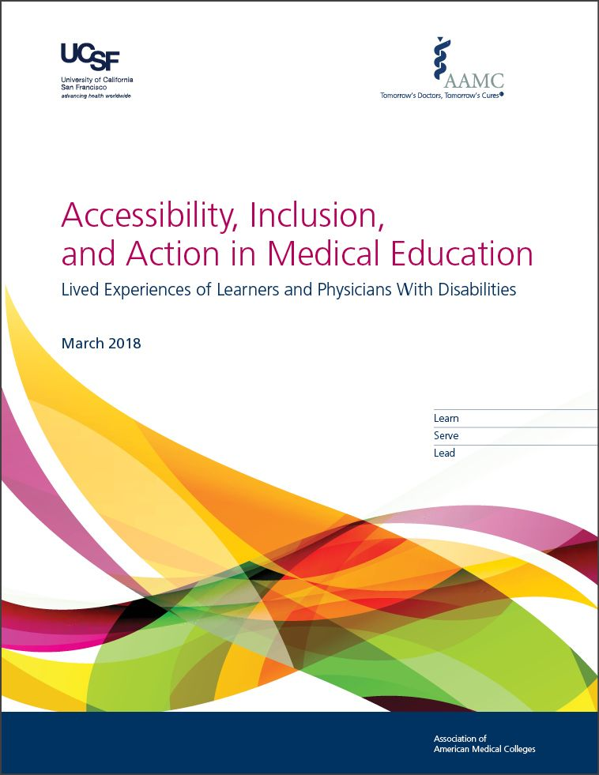
Accessibility, Inclusion, and Action in Medical Education: Lived Experiences of Learners and Physicians with Disabilities
Association of American Medical Colleges 2018

Slide 6
Other Resources
Discipline-specific organizations
National Organization of Nurses with Disabilities
DS professional associations
Association on Higher Education and Disability (AHEAD)
Coalition for Disability Access in Health Science Education
College’s website, student handbook, staff
Google like you’re a prospective student

Slide 7
Key Terminology
Didactic (adj.) = traditional, lecture-based curriculum
Clinical/Clerkship/Rotation (n. or adj.) = on-site supervised experiential learning and practice, similar to an internship
Preceptor (n.) = professional supervisor for a student’s clinical hours
Precept (v.) = the act of being a student’s preceptor
Intermediaries (n.) = staff member paired with a disabled student to assist with physical tasks which are not required clinical skills

Slide 8
Key Terminology (cont.)
Technical Standards (n.) = The essential abilities and characteristics required for program entry, continuation, and graduation; not clinical skills
OSCE (n.) = Objective Structured Clinical Exam; an experiential assessment of clinical skills with a standardized patient (actor); typically includes reviewing door notes (initial written information), patient interaction, and writing a case note.
Licensing/Certification/Board Exams (n.) = Required for licensure or certification; discipline specific (NCLEX, USMLE, etc.)

Slide 9
Understanding Discipline-Specific Accommodations
Focus area #2

Slide 10
Clinical Accommodations
Clinical site commute limit
Clinical rotation schedule adjustments (e.g. time of day, breaks)
Tardiness/absences/makeup hours
Communication access (e.g. interpreters, CART, specialized stethoscope)
Intermediaries
Lifting/movement restrictions
Feedback modality (e.g. 1:1, distraction-reduced, taking notes)

Slide 11
Other Accommodations
Leave of absence and program progress/cohorts
Extended time on OSCEs
Chemical sensitivities in labs (e.g. formaldehyde)
Remote participation or advanced PPE (e.g. COVID high-risk conditions)
Assistive tech solutions in lab

Slide 12
Developing Effective Relationships & Processes
Focus area #3

Slide 13
Strategies
Identify key players in college
Designate an office liaison (college model)
Approach as a partnership; ask about their concerns and suggestions
Make sure you’re on the same page about the basics (e.g. scope of disability, definition of a “reasonable accommodation”, language)
Do your homework: terminology, examples, resources
Honor patient safety

Slide 14
Identifying Areas for Collaboration
Focus area #4

Slide 15
Collaboration Ideas
Faculty Development
Accommodations and inclusive course design
Diversity and Inclusion Efforts
Rhetoric/Values
Education
Policies and Procedures
Accommodation statements
Technical standards: organic vs. functional
Attitudinal barriers and professional culture
Intersection with disability studies
Assessment/Data
HR details for intermediaries

Slide 16
Q&A
My Email: Crawford.843@osu.edu

