Slide 1
INTENT TO SUBMIT
Declaring intent in leo

Slide 2
contents
Introduction
Roles and Responsibilities
Declaring Intent from Pivot
When an opportunity is not in Pivot
Summary
For questions or support, contact ORSP at orsp@ohio.edu; 740.597.6777

Slide 3
introduction
The intent to submit is the first step in securing your place in the ORSP submission queue. So, please send your intent to submit a proposal to ORSP as soon as you have identified a potential funding source for your idea, research, or creative activity.
It is not necessary to have a complete draft of the proposal in hand to initiate a discussion.

Slide 4
Roles and responsibilities
Applicant should start early, collect preliminary data, and establish internal deadlines with ORSP Sponsored Programs Manager.
Applicant often begins writing application several months prior to application due date.
Applicant is ultimately responsible for the timely submission of the grant.
ORSP Sponsored Programs Manager will facilitate the submission by assisting with the proposal development; reviewing and approving proposals; managing the proposal submission process; and negotiating, accepting, and activating the award.

Slide 5
PIVOT
Pivot at Ohio University Connects Faculty and Researchers to:
The most comprehensive, editorially maintained database of funding opportunities available with more than 28,000 opportunities including research, training, scholarships and fellowships. Opportunities are added daily from government, institutions, foundations, and corporate sponsors.
International coverage spanning US, UK, Europe, Latin America, Australia/New Zealand, South Africa and more.
Automated funding opportunity matching and email alerts based user profiles and specified funding interests.

Slide 6
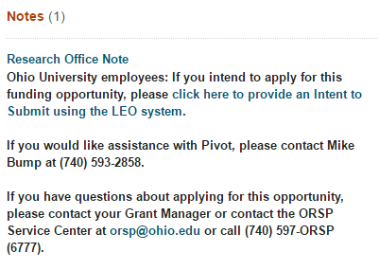
Declare intent from pivot
LEO has the capability to create an Intent to Submit based on a funding opportunity in the Pivot database. When accessing Pivot while on the Ohio University campus or logged on with your Ohio University account, scroll down to the bottom where you will see a link to LEO:
Click the link
For questions or support, contact ORSP at orsp@ohio.edu; 740.597.6777

Slide 7
Declare intent from pivot
LEO’s response will depend on the status of the opportunity for which you are applying. For most opportunities, you will be presented with the basic Intent to Submit form:
Check here to automatically
fill in your details
For questions or support, contact ORSP at orsp@ohio.edu; 740.597.6777

Slide 8
Declare intent from pivot
A ticket will be generated and assigned to the PI’s Grant Manager
For questions or support, contact ORSP at orsp@ohio.edu; 740.597.6777

Slide 9
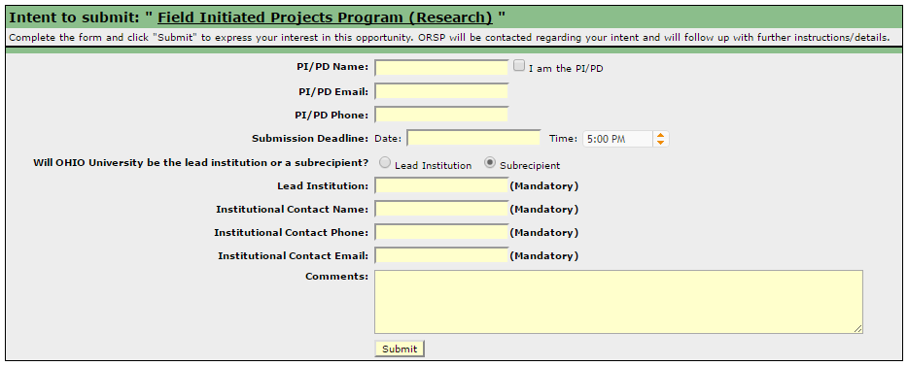
Declare intent from pivot
If OHIO University will be a subrecipient on this project, select “Subreceipient” and fill in the additional details:
For questions or support, contact ORSP at orsp@ohio.edu; 740.597.6777

Slide 10
Declare intent from pivot
A ticket will be generated and assigned to the PI’s Grant Manager
For questions or support, contact ORSP at orsp@ohio.edu; 740.597.6777

Slide 11
Declare intent from pivot
LEO will automatically create a Service Center ticket with the details of your Intent to Submit and send you an email.
Your Grant Manager will contact you to schedule the proposal preparation milestones.
You can monitor the ticket status in the ORSP Service Center module in LEO.
For questions or support, contact ORSP at orsp@ohio.edu; 740.597.6777

Slide 12
Declare Intent From Pivot Limited Submissions
If the Funding Opportunity you are applying for is a Limited Submission (marked in Pivot) you will be required to request to submit using the Limited Opportunity Request Form:
Provide comments and justification here.
Limited Requirements will be listed here.

Slide 13
Declare Intent From Pivot Limited Submissions
After you submit a Limited Submission Request, ORSP staff will evaluate your request along with any other requests to submit for the same opportunity.
You will be notified of the decision and what to do next.

Slide 14
Declare Intent From Pivot Opportunity not in LEO
Due to interface limitations with Pivot, ORSP staff must manually upload Funding Opportunities into LEO in order for them to be processed.
In the rare event you attempt an Intent to Submit before the Funding Opportunity has been uploaded, LEO will create a ticket requesting the upload of the missing Opportunity.
Once the Opportunity has been loaded, ORSP will contact you and you will be able to continue with your Intent to Submit.

Slide 15
When an Opportunity Is nOt In Pivot
While Pivot contains a comprehensive database of Funding Opportunities, there may be some opportunities not available through Pivot.
In those cases, you can enter the necessary details about the Funding Opportunity through LEO.
Access the Intent to Submit page from the home page in LEO:

Slide 16
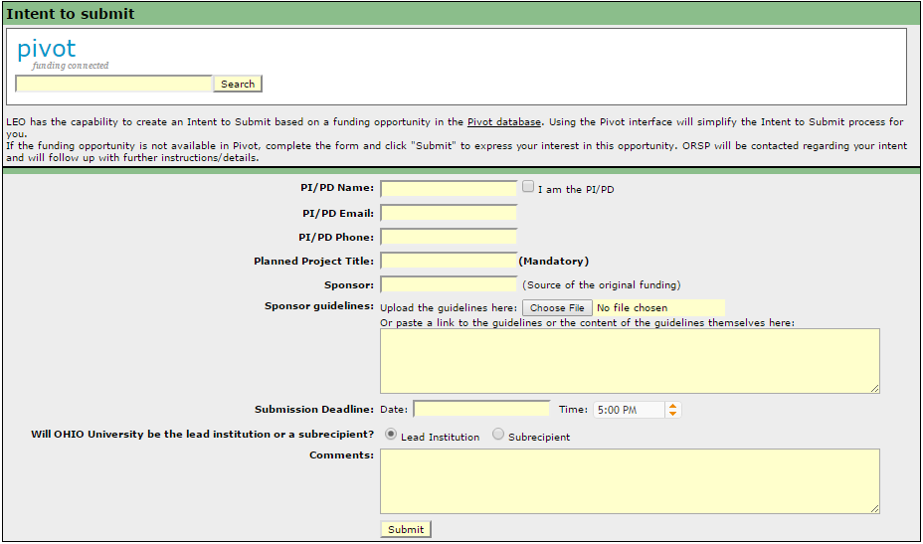
When an Opportunity Is nOt In Pivot
These fields are added to the Intent to Submit request
You can either upload the Sponsor’s guidelines, enter them into this text field, or put the web address for the sponsor’s guidelines in the text field

Slide 17
When an Opportunity Is nOt In Pivot
As with Funding Opportunities in Pivot, LEO will automatically create a Service Center ticket with your Intent to Submit details.
Your Grant Manager will contact you to continue the proposal preparation process.
You will receive an email with the ticket details, and can monitor the ticket status in the ORSP Service Center module in LEO.
For questions or support, contact ORSP at orsp@ohio.edu; 740.597.6777

Slide 18
Tips
Submit Early
Read the guidelines
Establish realistic internal deadlines
For questions or support, contact ORSP at orsp@ohio.edu; 740.597.6777

