Slide 1
ORSP Service Center User Tutorial
Contents
Accessing the Service Center
Creating a Ticket
Completing and Submitting a Ticket
Listing Tickets
Ticket Comments
Grant Manager Directory
Action Categories and Types
For questions or support, contact ORSP at orsp@ohio.edu; 740.597.6777

Slide 2
ORSP Service Center Accessing the Service Center
From the LEO Home Page
OR
From the menu
For questions or support, contact ORSP at orsp@ohio.edu; 740.597.6777

Slide 3
ORSP Service Center Accessing the Service Center
This is the ORSP Service Center Main Page
For questions or support, contact ORSP at orsp@ohio.edu; 740.597.6777

Slide 4
ORSP Service Center Creating a ticket
You can create a new ticket from the ORSP Service Center or the LEO menu
OR…
For questions or support, contact ORSP at orsp@ohio.edu; 740.597.6777

Slide 5
ORSP Service Center Creating a ticket
You can create a new ticket from a Transmittal or UT
From a UT, select “View Tickets”
On a Transmittal Review page, you
Can see any associated tickets, or
Create a new one by selecting
“Create a New Ticket”
Then “Create a New Ticket”
For questions or support, contact ORSP at orsp@ohio.edu; 740.597.6777

Slide 6
ORSP Service Center Creating a ticket
You can also create a new ticket based on a previous ticket
Click this icon. A new ticket will be created with all the same information as this one.
For questions or support, contact ORSP at orsp@ohio.edu; 740.597.6777

Slide 7
ORSP Service Center completing and submitting a ticket
This is your assigned ticket number
Current ticket status
Fields are explained on the following slides
For questions or support, contact ORSP at orsp@ohio.edu; 740.597.6777

Slide 8
ORSP Service Center completing and submitting a ticket Ticket fields
Ticket Status: The current status of the ticket
New: Created but hasn’t been sent to the Service Center
Queued: In the Service Center’s Queue but not assigned
Assigned: Assigned to a Manager
Returned: Returned from a Manager to the Service Center for further action
Completed: All actions completed; ticket it closed
Cancelled: Ticket was closed without action
For questions or support, contact ORSP at orsp@ohio.edu; 740.597.6777

Slide 9
ORSP Service Center completing and submitting a ticket Ticket fields
PI/PD Name/Email/Phone: The PI or PD associated with the project (optional).
Selecting “I am the PI” will fill in this information automatically from your HR record
eTF: The electronic Transmittal ID associated with this ticket (will be automatically filled in if you create a ticket from a Transmittal)
UT: The Uniterm number associated with this ticket (will be automatically filled in if you create a ticket from a UT)
(Clicking the first icon next to the eTF/UT field will allow you to search for a transmittal or UT. Clicking the second icon will display the transmittal or UT identified in the corresponding field)
For questions or support, contact ORSP at orsp@ohio.edu; 740.597.6777

Slide 10
ORSP Service Center completing and submitting a ticket Ticket fields
Due Date: The date by which this action needs to be completed
Action Category: The Category of action to be taken for this ticket
Action Type: The type of action to be taken for this ticket
(A complete list of Action Categories and Types is at the end of this presentation)
Subject: A short, descriptive subject for the ticket
Description: Explain clearly and in as much detail as necessary what action(s) you are requesting from the manager
Comment: This is placed into a comment log and is used to document progress and updates to the ticket over time
For questions or support, contact ORSP at orsp@ohio.edu; 740.597.6777

Slide 11
ORSP Service Center completing and submitting a ticket Ticket Buttons
Send update notifications: If these boxes are checked, the corresponding person/people (you and/or the PI) will receive email updates as the ticket progresses.
Save and Close: Save your changes on this ticket, but don’t submit it to the Service Center (nobody will see this ticket until after it’s submitted)
Submit to Service Center: Save your changes and send it to the Service Center for action
Cancel Ticket: Cancel this ticket and don’t send it (the number will be used up, but it won’t show up on any of your pages)
Exit Without Saving: Exit this page without saving any changes (it will remain accessible by you, but nobody else)
For questions or support, contact ORSP at orsp@ohio.edu; 740.597.6777

Slide 12
ORSP Service Center completing and submitting a ticket
Once you submit the ticket, you’ll see the following acknowledgement page:
For questions or support, contact ORSP at orsp@ohio.edu; 740.597.6777

Slide 13
ORSP Service Center Listing Tickets
All Ticket lists will appear in a table like this:
The buttons at the top can be used to display or hide various fields
The pull-down lists at the bottom can be used to filter for data in each field
The search field at the top will search all fields for whatever you type (not case-sensitive)
Click on any column header to sort by that column
Click on the magnifying glass to view that ticket
For questions or support, contact ORSP at orsp@ohio.edu; 740.597.6777

Slide 14
ORSP Service Center listing tickets
My Open Tickets
Shows all open tickets where you are listed as the Originator or PI/PD
My Tickets
Shows all tickets (open, completed, cancelled) where you are listed as the Originator or PI/PD
For questions or support, contact ORSP at orsp@ohio.edu; 740.597.6777

Slide 15
ORSP Service Center listing tickets
Open Tickets
Shows all submitted, open tickets that you have access to
Does not include new tickets that haven’t been submitted
Includes tickets where you are the Originator or PI/PD
Includes tickets associated with a UT or eTF you are associated with
If you are a delegate, includes all tickets for your unit(s)
All Tickets
Shows all tickets that you can access, regardless of status
Includes all the categories listed above under “Open Tickets”
This list may take a long time to load
For questions or support, contact ORSP at orsp@ohio.edu; 740.597.6777

Slide 16
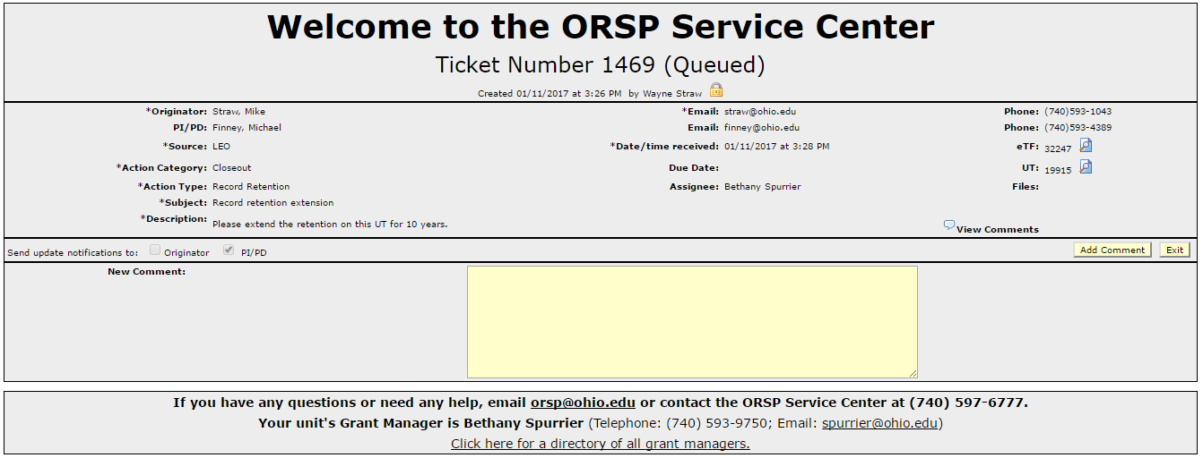
ORSP Service Center Ticket Comments
Comments can be added to any open ticket you’re able to access
Comments will be sent via email to the assigned manager (if it isn’t assigned yet, all comments will be sent when a manager is assigned)
Enter Comment Here
Click to save
For questions or support, contact ORSP at orsp@ohio.edu; 740.597.6777

Slide 17
ORSP Service Center Grant manager directory
Your Grant Manager is listed at the bottom of all Service Center pages
You can also find any individual’s or unit’s Grant Manager by clicking the link in this box or selecting “Grant Manager Directory” from the Service Center menu or the LEO home page.
For questions or support, contact ORSP at orsp@ohio.edu; 740.597.6777

Slide 18
ORSP Service Center Grant manager directory
You can also find any individual’s or unit’s Grant Manager by clicking the link in this box or selecting “Grant Manager Directory” from the Service Center menu or the LEO home page.
For questions or support, contact ORSP at orsp@ohio.edu; 740.597.6777

Slide 19
ORSP Service Center Grant manager directory
Start entering a name, and options will be displayed to select
After you select the Unit or Faculty Member name, the Grant Manager will be displayed
For questions or support, contact ORSP at orsp@ohio.edu; 740.597.6777

Slide 20
ORSP Service Center Action categories and types
Generating Your Idea
Grant Writing and Development
Internal Funding Opportunities
Funding Opportunities
Funding Opportunities (PIVOT)
Gift vs. Grant
Grants
Contracts
Limited Submissions Process
Designated Advancement Primacy Sponsors
Subsidiaries
Core
For questions or support, contact ORSP at orsp@ohio.edu; 740.597.6777

Slide 21
ORSP Service Center Action categories and types
Proposal
PI/PD Eligibility
Intent to Submit
Proposal forms/format/package prep
Review and interpret proposal guidelines
Budget
Compliance
Contract Preview
Research Incentive Distribution
Space
Subrecipients
Intellectual Property (IP) and Tech Transfer (TT)
For questions or support, contact ORSP at orsp@ohio.edu; 740.597.6777

Slide 22
ORSP Service Center Action categories and types
Proposal Submission
Transmittal Form for Proposal Review and Approval
Electronic Systems
Authorized Organizational Representative (AOR)
Contract Submission
For questions or support, contact ORSP at orsp@ohio.edu; 740.597.6777

Slide 23
ORSP Service Center Action categories and types
Award Negotiation and Setup
Just-in-time requirements
Departmental Guarantee Account
Contract Negotiation
Notice of Award
New Sponsor/Customer Setup
Terms and Conditions
Subcontracting
Purchased Service
Signature Authority
Account Setup
Payment Terms and Billing Requirements
Award Acceptance
Compliance
For questions or support, contact ORSP at orsp@ohio.edu; 740.597.6777

Slide 24
ORSP Service Center Action categories and types
Award Management
Audits
Modification
Equipment Inventory Management
Monitor expenditures
Report
Renewal proposals/awards/continuations
Time and Effort Reporting
Cash Management
FOIA or Open Records Request
Research Incentive (RI) Distribution
Student Stipends
Procurement
For questions or support, contact ORSP at orsp@ohio.edu; 740.597.6777

Slide 25
ORSP Service Center Action categories and types
Closeout
Closeout
Relinquishments
Terminations
Record Retention
Infrastructure
Service Center
LEO
Record Management
Communications
Training Program
Unknown
Unknown
For questions or support, contact ORSP at orsp@ohio.edu; 740.597.6777

