Slide 1
TOP FIVE FINANCIAL AID QUESTIONS ANSWERED
Discovery Day 2022
Taylor Searls
Assistant Director of Scholarships

Slide 2
HOW DO I APPLY FOR FINANCIAL AID?
WHERE DO I GET SCHOLARSHIPS?
WHAT’S IT GOING TO COST?
WHAT OTHER AID CAN I GET?
WHAT HAPPENS NEXT?

Slide 3
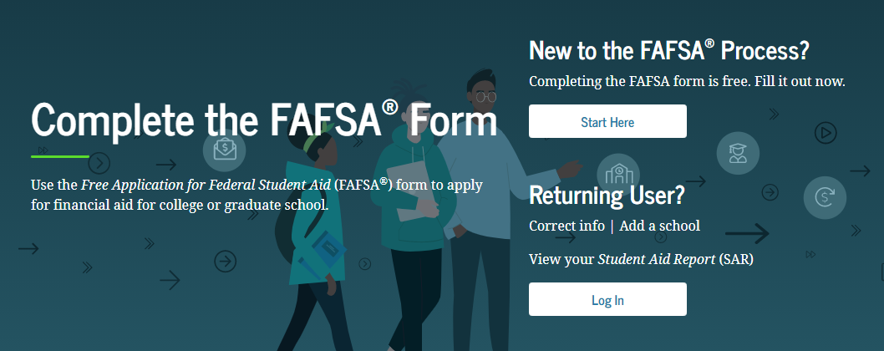
1. HOW DO I APPLY FOR FINANCIAL AID?
FAFSA = FREE APPLICATION FOR FEDERAL STUDENT AID

Slide 4
1. HOW DO I APPLY FOR FINANCIAL AID?
The FAFSA is FREE
Available beginning October 1 at https://studentaid.gov
File early to ensure OHIO receives your results by January 15
Parent demographic and financial information is required
FSA User ID is required: https://studentaid.gov/fsa-id/create-account

Slide 5
1. HOW DO I APPLY FOR FINANCIAL AID?
Use the IRS Data Retrieval Tool to import 2021 tax data
All students are encouraged to complete the FAFSA
Tax transcripts and W-2 forms may be requested
Have things changed since 2021 for your family?

Slide 6
2. WHERE DO I GET SCHOLARSHIPS?

Slide 7
2. WHERE DO I GET SCHOLARSHIPS?
Submit a complete application for admission by November 15
Awards consider merit and blend of merit and need
Diversity scholarships: https://www.ohio.edu/diversity/omsar
Private funded university scholarships

Slide 8
2. WHERE DO I GET SCHOLARSHIPS?
OHIO EXCELLENCE AWARDS
https://www.ohio.edu/admissions/tuition/ohio-excellence-awards
First-year students new to Athens campus
Academic merit determined by high school GPA
Optional ACT/SAT score submission only used if beneficial
Financial need determined by the FAFSA
Renewable for up to four years total
Submit complete application for admission by November 15

Slide 9
3. WHAT’S IT GOING TO COST?

Slide 10
3. WHAT’S IT GOING TO COST?
The OHIO Guarantee+ ™ +™
First program of its kind in the state
For Ohio residents and non-residents
Enables students to pay a single fixed-rate across four years
Truly comprehensive-includes orientation fees, technology fees, network fees, general fees, graduation application fees, most course fees and most non-resident surcharge fees.
Scholarships and financial aid packages hold their value
www.ohio.edu/guarantee

Slide 11
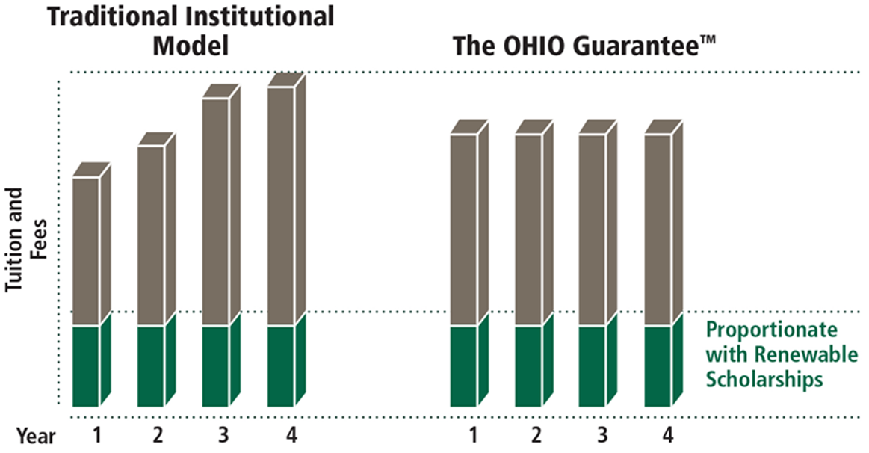
3. WHAT’S IT GOING TO COST?
The OHIO Guarantee+ ™ +™

Slide 12
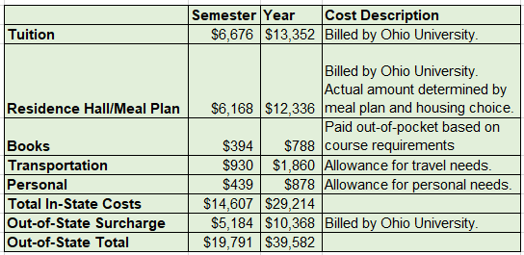
3. WHAT’S IT GOING TO COST?
Ohio University Cost of Attendance 2022-2023

Slide 13
4. WHAT OTHER AID CAN I GET?

Slide 14
4. WHAT OTHER AID CAN I GET?
Federal grants:
Pell Grant
Supplemental Educational Opportunity Grant (SEOG)
Teacher Education Assistance for College and Higher Education (TEACH)
State of Ohio grants:
Ohio College Opportunity Grant (OCOG)
Other more specific aid programs
www.ohiohighered.org/sgs
Ohio University grants

Slide 15
4. WHAT OTHER AID CAN I GET?
Federal Work-Study
Financial need as determined by FAFSA
Paid based on hours worked
Money isn’t applied to university bill, but sent in bi-weekly paychecks.
Student Hourly Employment - https://www.ohiouniversityjobs.com/
Program to Aid Career Exploration (PACE)

Slide 16
4. WHAT OTHER AID CAN I GET?
Student loans are available to all eligible students filing a FAFSA.
Federal Student Loans are a form of financial aid.
Students are awarded on their year in school.
Freshmen – Total of $5,500 the maximum available
Sophomore – Total of $6,500
Junior – Total of $7,500
Senior – Total of $7,500

Slide 17
4. WHAT OTHER AID CAN I GET?
Student loans MUST be repaid.
Repayment begins six months after you graduate or drop below half-time status.
Loan types:
Subsidized loans (do not accrue interest while in school)
Unsubsidized loan (accrue interest while in school)
Studentaid.gov

Slide 18
4. WHAT OTHER AID CAN I GET?
Private loans
Require a credit-worthy co-signer
www.ohio.edu/financial-aid/types/loans/private-loans
Parents can apply for Federal Loans
Parent would need to be credit-worthy or have a credit-worthy co-signer
www.ohio.edu/financial-aid/types/loans/federal-loans

Slide 19
5. WHAT HAPPENS NEXT?

Slide 20
5. WHAT HAPPENS NEXT?
Submit your completed application for admission by November 15,2022.
Submit your FAFSA by January 15, 2023.
Check your OHIO Student Center and complete any listed to-do items.
Watch for merit-based scholarship offers mailed in December.
Send updated credentials through January 15, 2023.
Expect your comprehensive Financial Aid Offer in your mailbox by late-February.
Complete steps to secure your financial aid
www.ohio.edu/financial-aid/checklist

Slide 21
NEED HELP?
financial.aid@ohio.edu
740.593.4141
www.ohio.edu/financial-aid
Twitter: @OHIOStuFinAid

Slide 22
Thank you!

