Slide 1
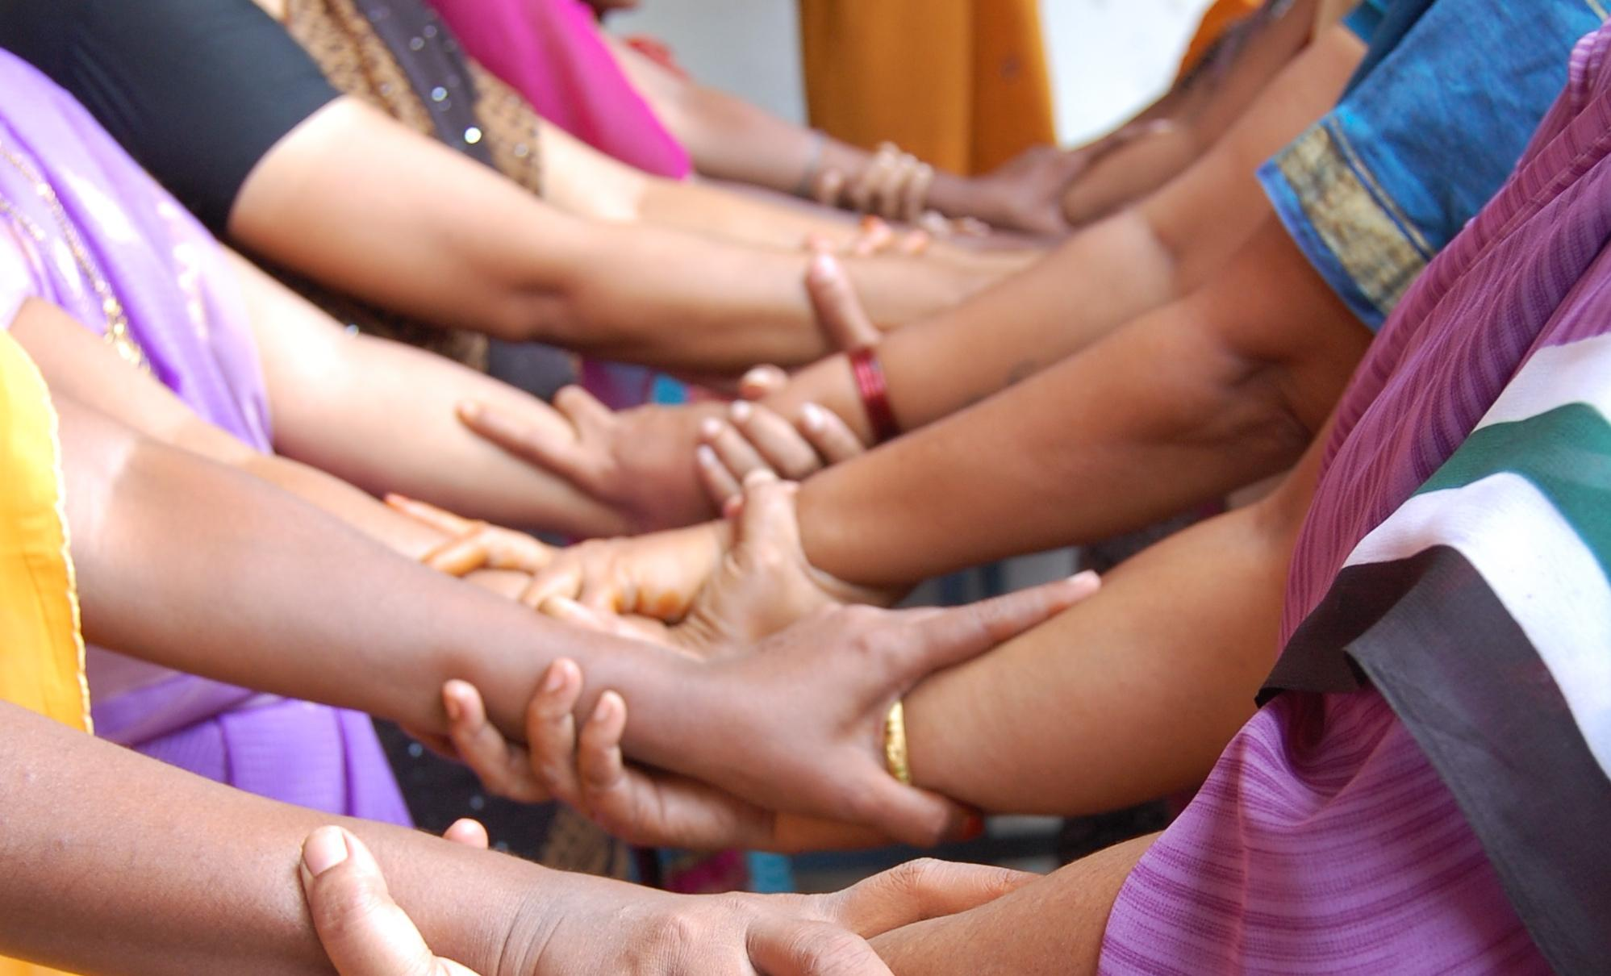

Look Good.
Feel Good.
Do Good.

Slide 2
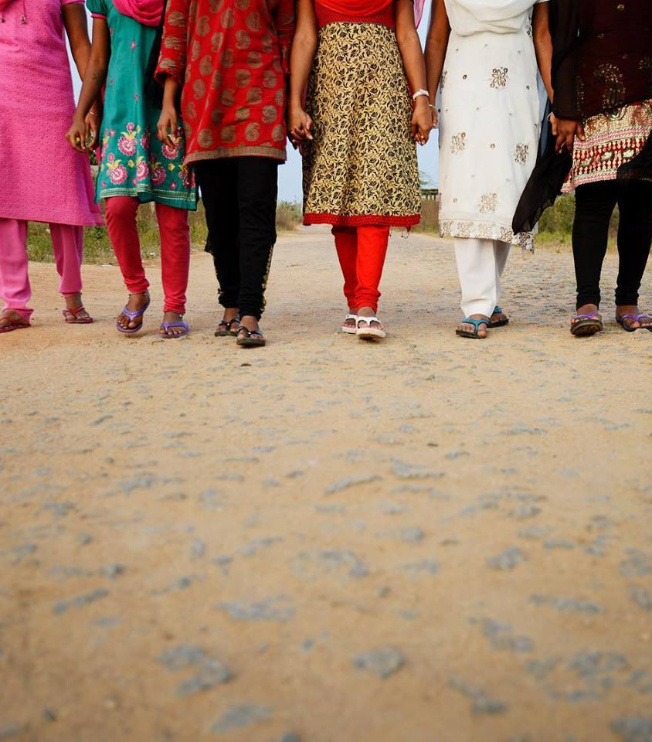
Table of Contents
Silhouette Entry Requirements
Unisex Jersey Tee
Women’s Slouchy V Neck Tee
Women’s Flowy Ribbed Long Sleeve
Women’s Flowy Off Shoulder Long Sleeve

Slide 3
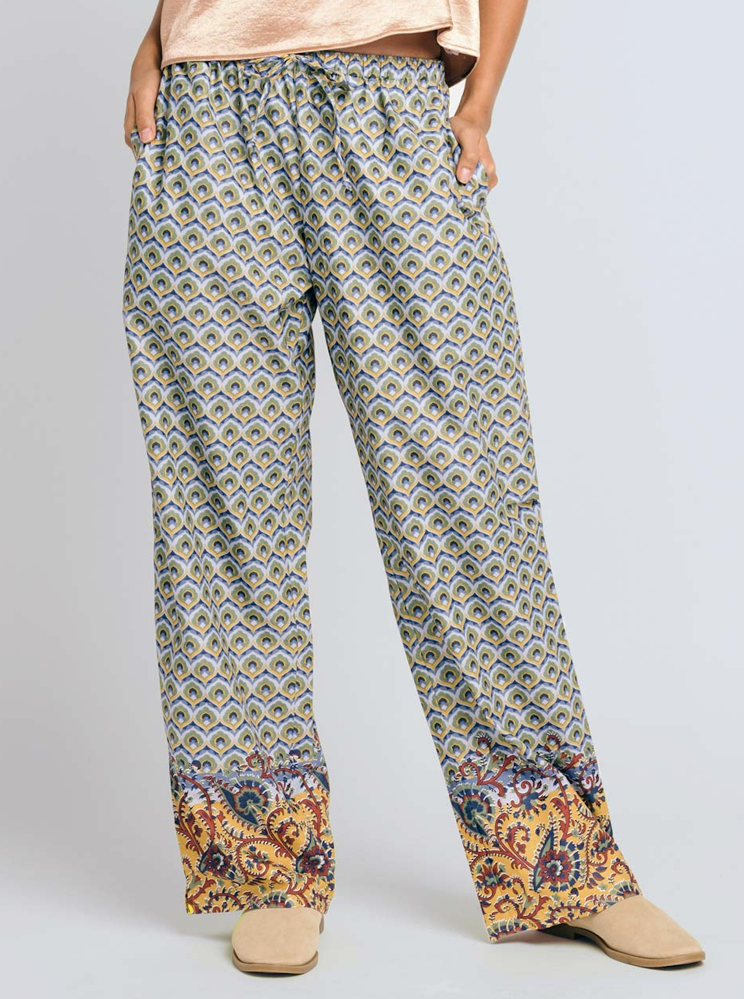
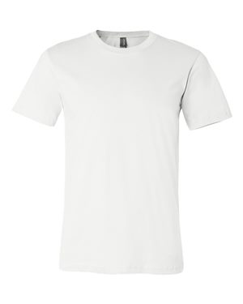
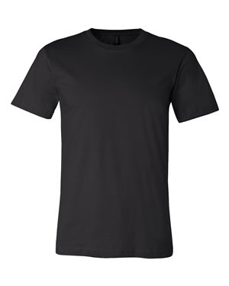
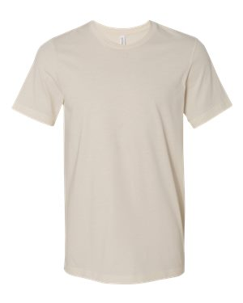



Silhouette Entry Requirements
Each entry must have the following files:
Optional files:
Black design version:
White design version:
Full color (or greyscale) design on selected color shirt:
1. With transparent background
1. With transparent background
1. With transparent background
2. On white shirt
2. On black shirt
2. On selected color shirt
Submit a static image (.jpg or .png) and editable file (.eps or .ai) for each color variation
*If your design is not chosen, you still own it.
Bonus Points!
Consider designing your shirt to match with a pair of Sudara's punjammies.
Notes:
The idea is that this shows that “entering is as easy as 1-2-3”. Upload to white, upload to black, add sizzle, add bonus matching items. AND - don’t worry, if your design is not chosen, you still own it.

Slide 4
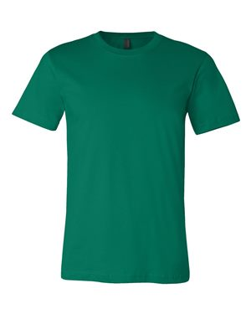
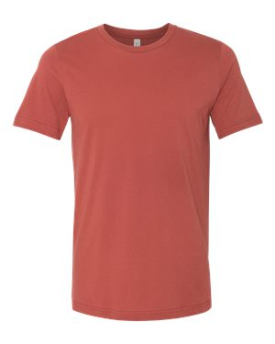
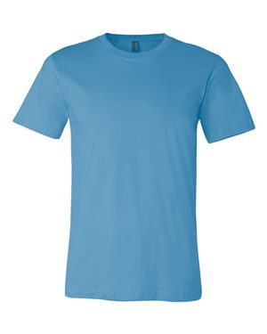
Silhouette Option: Unisex Jersey Tee
Kelly
Soft Cream
Rust
Ocean
Blue
White
Black
Step 1: Upload your design in black with a transparent background.
Step 2: Upload your design in white with a transparent background.
Step 3: Designers choice! Upload your full color or grayscale design on your choice of tee color from options above.*
*If your design is chosen, final tee color and style selections will be made at the sole discretion of Sudara.

Slide 5
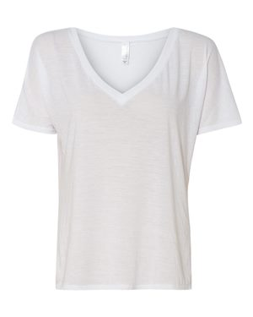
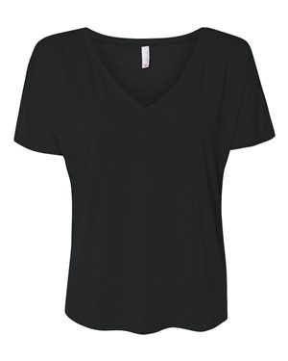
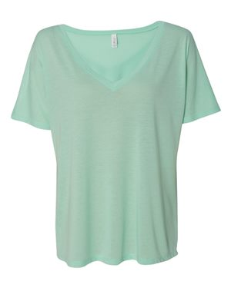
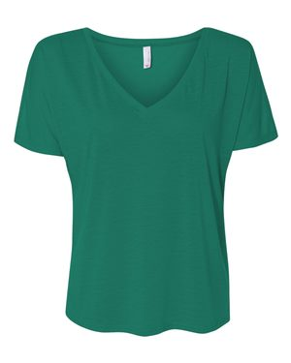
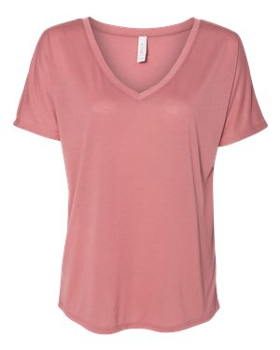
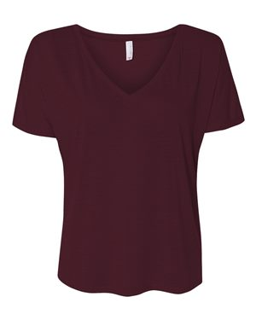
Silhouette Option: Women’s Slouchy V Neck Tee
Mint
Kelly
Mauve
Maroon
White
Black
Step 1: Upload your design in black with a transparent background.
Step 2: Upload your design in white with a transparent background.
Step 3: Designers choice! Upload your full color or grayscale design on your choice of tee color from options above.*
*If your design is chosen, final tee color and style selections will be made at the sole discretion of Sudara.

Slide 6
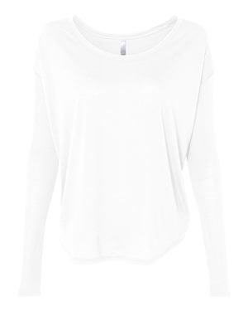
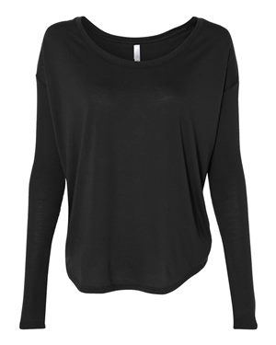
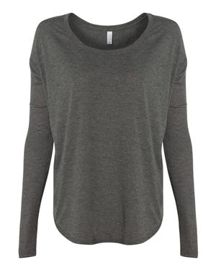
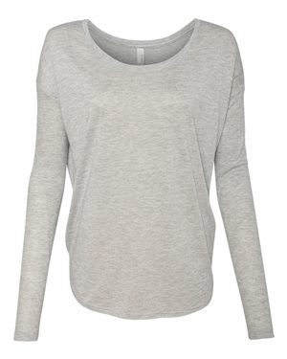
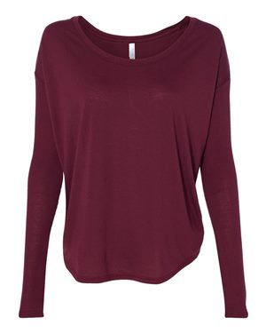
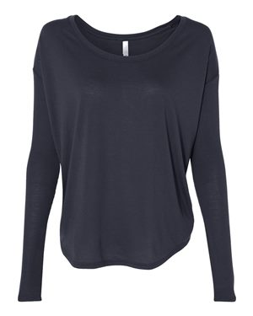
Silhouette Option: Women’s 2x1 Ribbed Long Sleeve Tee
Dark Grey
Athletic Heather
Maroon
Midnight
White
Black
Step 1: Upload your design in black with a transparent background.
Step 2: Upload your design in white with a transparent background.
Step 3: Designers choice! Upload your full color or grayscale design on your choice of tee color from options above.*
*If your design is chosen, final tee color and style selections will be made at the sole discretion of Sudara.

Slide 7
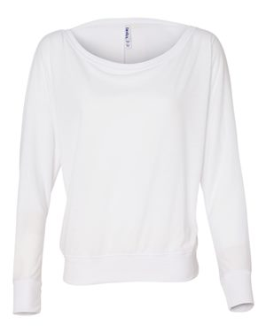
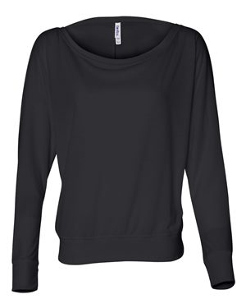
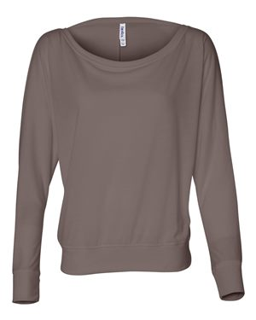
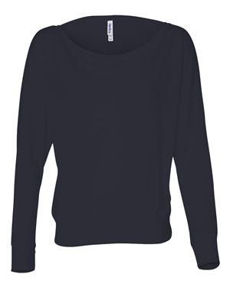
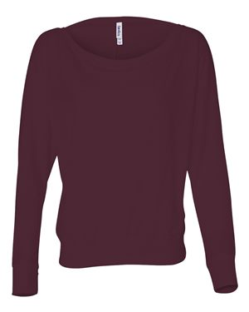
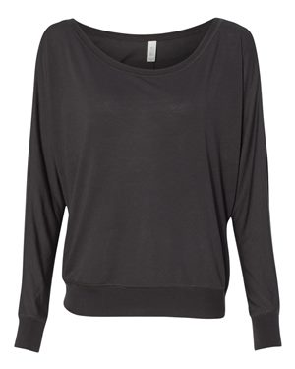
Silhouette Option: Women’s Flowy Off Shoulder Long Sleeve Tee
Pebble
Midnight
Maroon
Dark Grey
White
Black
Step 1: Upload your design in black with a transparent background.
Step 2: Upload your design in white with a transparent background.
Step 3: Designers choice! Upload your full color or grayscale design on your choice of tee color from options above.*
*If your design is chosen, final tee color and style selections will be made at the sole discretion of Sudara.

Slide 8
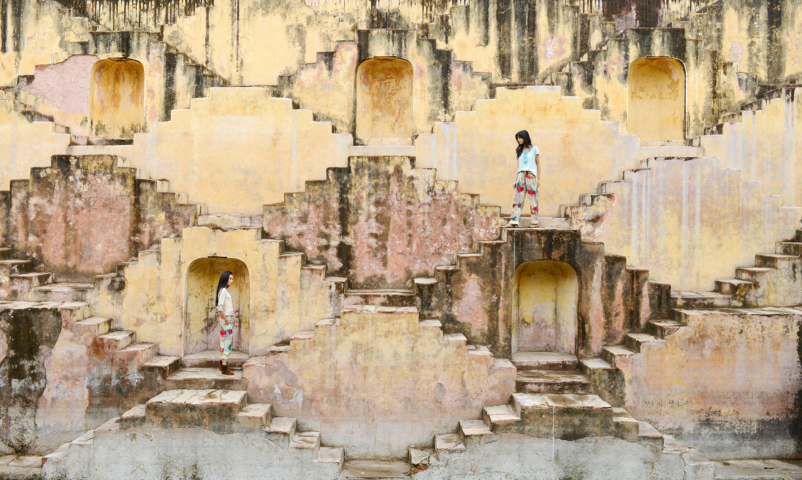
sudara.org
info@sudara.org
(844) 478-3272

