Slide 1

*How Learning Works: 7 Research-Based Principles for Smart Teaching (and Learning!)
Meg Flanigan, PhD Associate Director, Center for Teaching and Learning Office of Instructional Innovation
* Adapted from Ambrose et al, 2010

Slide 2

Notes:
But before we start, I just want to emphasize that teaching is primarily about working with human beings. It's difficult and it can be messy. And we all, at some level, are afraid that we might not get it right. So I just want to let you know that it's ok to feel like that. Our students are also afraid - of failure, of doing the wrong major, of not making friends. So bear in mind that we are all in this together. And that there is a lot that we do know that can help you.

Slide 3
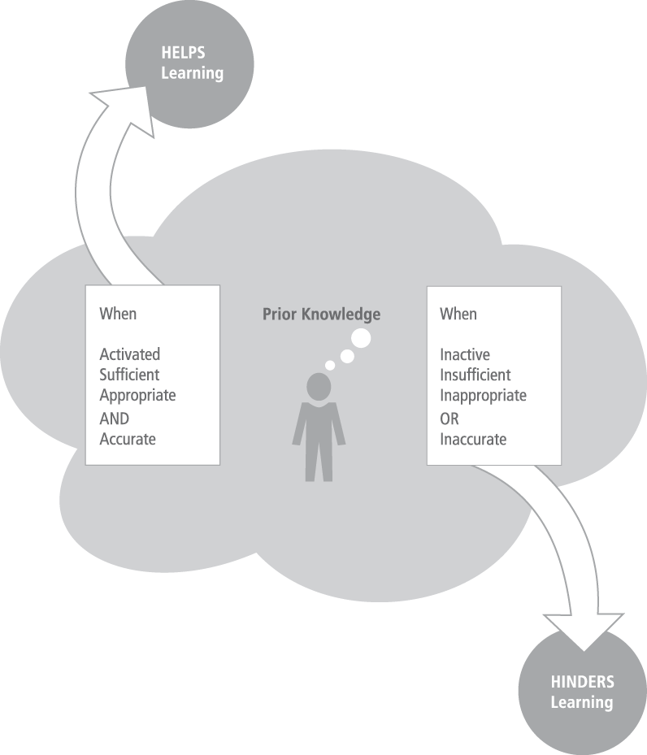
Prior knowledge
may help or
hinder learning
Use Classroom Assessment
Techniques, Knowledge-Confidence
Surveys, etc
Notes:
Don’t come as a blank slate. But varies from student to student. No matter the topic, we want to enhance student learning by connecting material to the students’ prior knowledge and experience. But we (and students) sometimes overestimate what that is. Prior knowledge matters. It could be correct but need to be activated, could be lacking, could be inaccurate. Lots of ways to address this CAT book, self-test, knowledge confidence surveys, etc.

Slide 4
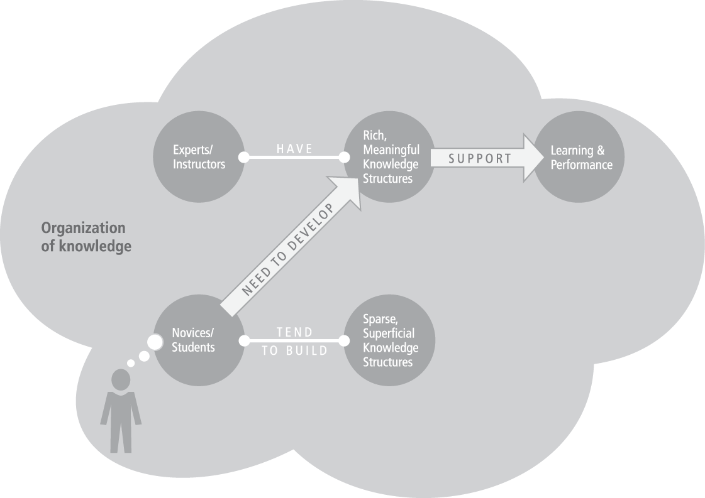
2. How we organize knowledge influences how we learn and apply what we know
Encourage use of concept maps
Notes:
As experts in a field we create and continually update rich, complex networks that connect important facts to concepts and procedures. Experts have a higher density of connections and we rely on deep underlying principles
Novices tend to learn information as disconnected chunks!. Overwhelmed by what feels like minutae. Need to help students see and make connections.

Slide 5
3. Motivation determines, directs and sustains what we do to learn
Notes:
We know that motivation that comes from within - intrinsic motivation - is much more powerful for learning than any type of external motivation could ever be. And so it's not all on us to motivate our students. But there are things we can do. We can explicitly articulate the value of the material the students are studying, whether in terms of future careers or transferrable life skills. And we can transmit the message that we expect the students to succeed if they follow our guidelines. Talking in terms of weed-out classes, etc, is not helpful and serves only to increase anxiety.

Slide 6
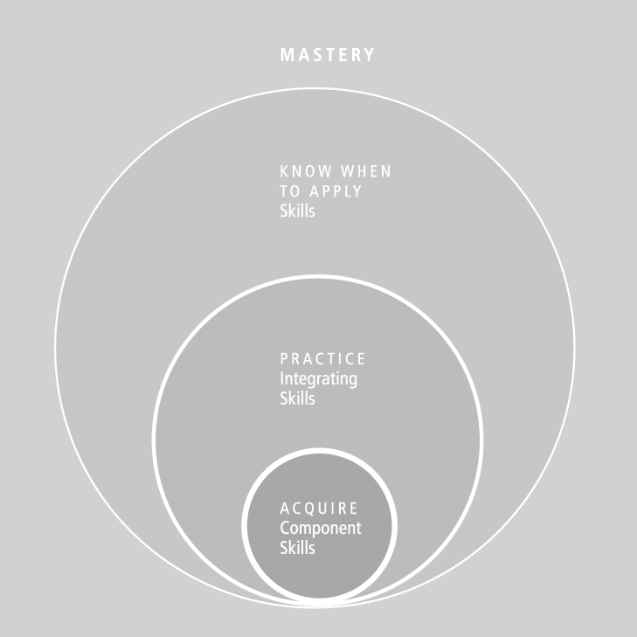
4. To develop mastery, we must acquire component skills, practice integrating them, and know when to apply what they have learned
Notes:
And so we must give our students ample opportunity to for formative assessments, allowing them to practice new skills, get them wrong, and learn from mistakes. In this way the information and skill set will be retained.

Slide 7
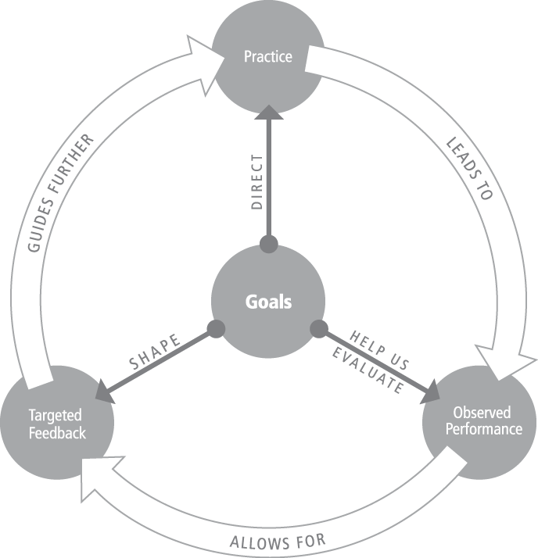
5. Goal-directed practice coupled with targeted feedback enhances the quality of learning
Make use of
Rubrics –
& share the expectations
up front
Notes:
And so, of course, that m,eans we must provide timely feedback. If the class is large, we can report back on general areas that need work, etc, but we should try where we can to also give trageted feeback

Slide 8
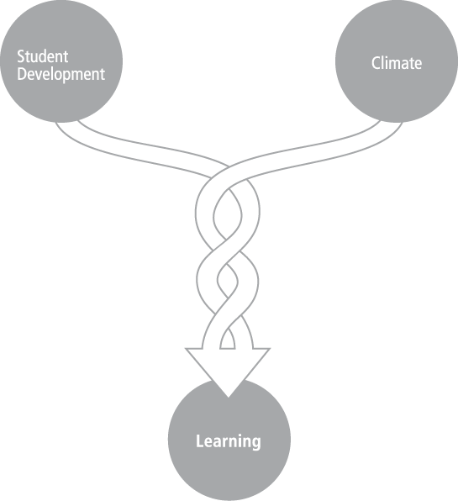
6. Current level of development interacts with the social, emotional, and intellectual climate of the course to impact learning
Classroom surveys
can be helpful
Notes:
We all know – and might well know from our own experiences as students – that a great deal goes on in the lives of students that can impact their learning. And that many of the issues have nothing to do with academics. Student age, backgrounds, life events, and climate in the classroom can all impact students’ abilities to cope with classroom work. It’s important to be aware of what’s going on in the lives of students so that if performance drops off, you can reach out.

Slide 9
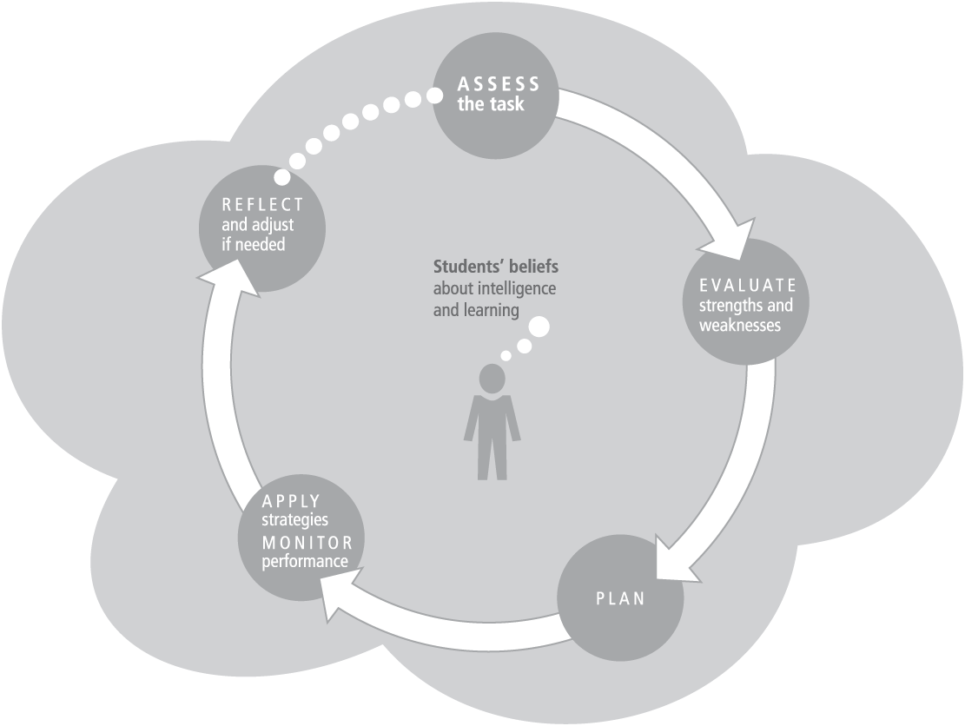
7. To become self-directed learners, students must learn to monitor and adjust their approaches to learning
Remind them about the
Academic Achievement Center
BUT FEW STUDENTS DO THIS NATURALLY
Notes:
Include student reflective portfolios. Have them consider what is working well, not so well. Make them consider what should change and how they should do that After exams, big assignments, include periods

Slide 10
Resources
Classroom Assessment Techniques
Concept Maps
Value Rubrics
Building Rapport/Using Surveys
Academic Achievement Center
In Part 2: Evaluate Scenarios. Determine which of the
learning principles is at play and what to do about it.

