Slide 1



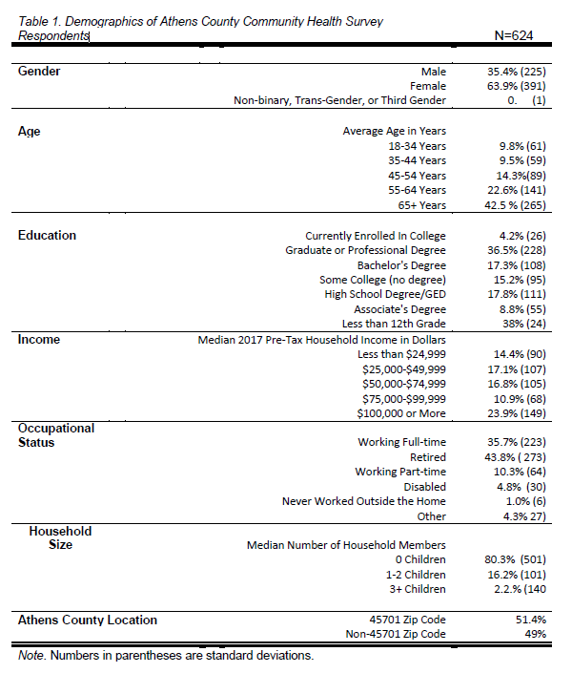
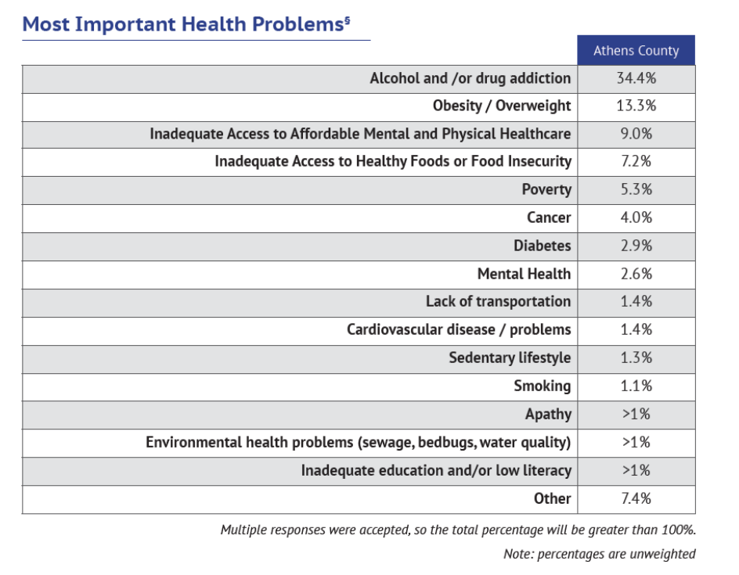
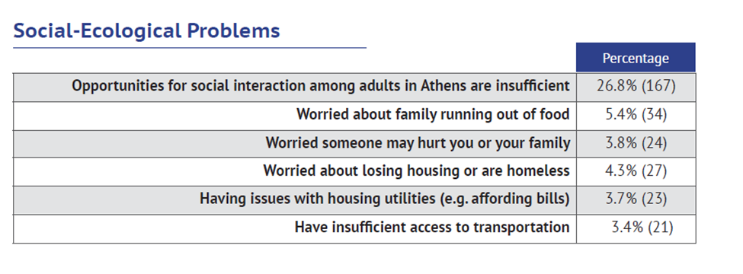
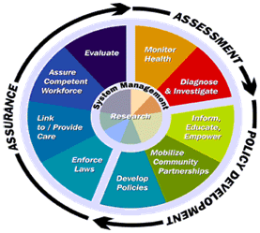
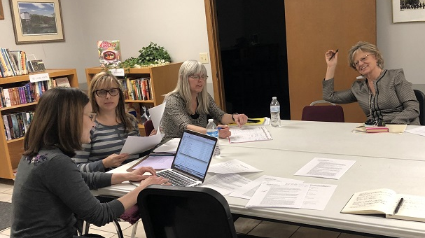
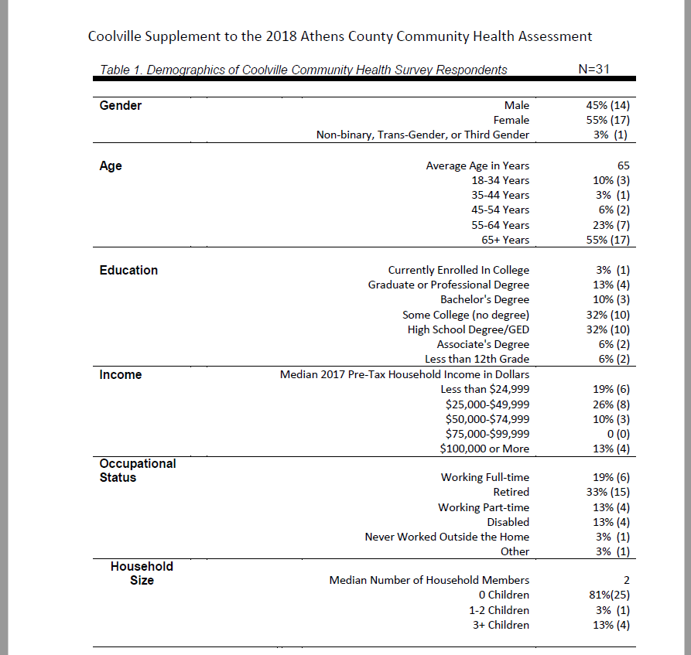
Localized Community Health Assessments for Athens County Communities
Sharon Casapulla, Ed.D
Ohio University, Heritage College of Osteopathic Medicine, Office of Rural and Underserved Programs
Introduction
Results
Discussion
Since the late 1990s, the Institute of Medicine (IOM) has called for strengthening the countries public health infrastructure.² In 2003, the IOM recommended systematic review of health departments as a way to improve public health.³
In 2007, the Public Health Accreditation Board (PHAB) was formed.⁴ The Robert Wood Johnson Foundation and the CDC supported the initial activities of PHAB which has become the public health accrediting body. The voluntary public health accrediting process was launched in 2011. All local health districts in Ohio must apply for accreditation by 2018 and to become accredited by 2020.⁶
As of this writing, 29 of the 113 local health districts in Ohio have become accredited under PHAB.⁶
National Association of County and City Health Officials (NACCHO) has developed resources to support health departments in their efforts toward accreditation.
The MAPP Mobilizing for Action through Planning and Partnerships (MAPP) Process from NACCHO involves four assessments:
Local Public Health System Assessment
Community Health Status Assessment
Forces of Change Assessment
Community Themes and Strengths Assessment.
Forces of Change are the challenges or threats as well as the opportunities that are operating within a community that can impact public health. The Forces of Change (FOC) Assessment and the Community Strengths Assessment were sent via email to 30 individuals on the Community Health Assessment Steering Committee and 21 individuals completed the assessments. See Figure 1 and Figure 2 for results.
Community Health Status Assessment : A total of 4,000 addresses were randomly selected from the residential addresses in Athens County and 624 (16%) residents completed the survey. See Table 1 for the demographic breakdown of the respondents. Table 2 represents the most important health issue in Athens County. Table 3 represents the most important socio-ecological problems.
The health priorities identified by the overall sample differed somewhat from those identified by the subsample of the communities.
While most communities identified that alcohol and or dug addiction was the biggest health problem facing the county, obesity was listed as the second most important health problem in the county.
At the community level, however, after alcohol and drug addiction, the health priorities were different. Stewart and Shade ranked poverty as the second most important health problem. Trimble ranked cancer as the second most important health problem
Table 1. Demographics of Athens County Respondents (N=624)
Table 2. Most Important Health Problems in Athens County (Overall Sample)
Forces of
Change
Economic Challenges
Opioid Epidemic
Integrated Care
Mental health issues
Decrease in Smoking – Increase in Vaping
Transportation improving
Aging Population
Conclusion
Table 3. Most Important Socio-Ecological Problems in Athens County (Overall Sample)
MPH Core Competencies Addressed:
Synthesize a body of scientific literature in order to document the social, behavioral, and environmental determinants of a specific health behavior among a specified population.
Communicate, both orally and in writing, outcomes of a diagnostic investigation of a specific health disparity among a rural community.
Objective
Figure 1. Results of Forces of Change Assessment
Athens City County Health Department will be applying for accreditation in 2019.
One significant part of accreditation is community engagement. Domain 1 of the PHAB Standards and Measures is to specifically, “Conduct and Disseminate Assessments Focused on Population Health Status and Public Health Issues Facing the Community.” ⁷
Athens City County Health Department (ACCHD), which serves the residents of the city of Athens and residents throughout Athens County, conducted a community health assessment in 2018.
Community
Assets
Health Systems
Community Challenge Teams
Local Food
Local Organizations
Green Space
University partners & researchers
Education
Technology to connect people
Methods
Figure 3. Presentation of CHA report at the Coolville Community Challenge Team Meeting
We followed the Mobilizing for Action through Planning and Partnerships (MAPP) Process. The Forces of Change (FOC) assessment was sent via email to 30 individuals on the Community Health Assessment Steering Committee.
Primary data for ACCHD 2018 Community Health Assessment came from the 2018 Athens County Health Survey. Representatives from ACCHD and other community stakeholders participated in a group session that identified the priority health issues facing Athens County residents and outlined the key elements of a strategic plan to address these issues.
Community reports were developed for Coolville, Guysville and Stewart, Shade, New Marshfield and The Plains. Meetings in The Plains and Coolville were held to disseminate results and engage stakeholders in confirming the results of the larger report.
Figure 2. Results of Community Strengths Assessment
Figure 4. The Athens County Community Health Assessment Steering Committee at the prioritization meeting
References
Table 4. Demographics of Coolville Respondents (N=31)
Community Level Reports: We developed and disseminated community reports for Coolville, Guysville and Stewart, Shade, New Marshfield and The Plains. The community meetings engaged stakeholders in discussion about the findings in the reports and confirming the results of the larger report.
Table 5 compares local community health priorities to overall county priorities.
https://www.cdc.gov/publichealthgateway/publichealthservices/essentialhealthservices.html
Institute of Medicine. The Future of the Public Health. Washington, DC: National Academies Press; 1988.
Institute of Medicine. The Future of the Public's Health in the 21st Century. Washington, DC: National Academies Press; 2003.
Beitsch LM, Corso LC, Davis MV, Joly BM, Kronstadt J, Riley WJ. Transforming public health practice through accreditation (a user guide for the special accreditation issue) J Public Health Manag Pract. 2014;20(1):2–3
http://codes.ohio.gov/orc/3701.13 Ohio Revised Code Title [37] XXXVII HEALTH - SAFETY - MORALS Chapter 3701: DEPARTMENT OF HEALTH 3701.13 Department of health - powers.
https://www.phaboard.org/who-is-accredited/#Ohio
PHAB. Standards and Measures. 2014. Public Health Accreditation Board.
Institute of Medicine (US) Committee on Using Performance Monitoring to Improve Community Health; Durch JS, Bailey LA, Stoto MA, editors.Washington (DC): National Academies Press (US); 1997.
 | Coolville | Shade | Stewart | The Plains | Trimble | Athens County
Alcohol and /or drug addiction | 2 | 1 | 1 | 1 | 1 | 1
Obesity |  |  |  |  | 3 | 2
Inadequate access to affordable mental and physical healthcare | 1 | 3 | 3 | 2 |  | 3
Poverty |  | 2 | 2 | 3
Cancer | 3 |  |  |  | 2
Table 5. Most Important Health Problems by Community Compared to Athens County Overall
Notes:
Forces of Change (FOC) assessment was May 24, 2018 and was closed September 30, 2018.It was sent via email to 30 individuals on the Community Health Assessment Steering Committee and 21 individuals completed the assessment.
The questions for the FOC assessment were derived from the NACCHO website sample FOC assessment.
Primary data for Athens City County Health Department 2018 Community Health Assessment came from the 2018 Athens County Health Survey, which included a representative survey of Athens County adult residents. From July 2018 through October 2018, the questionnaire was completed via Internet or by mail. A total of 4,000 addresses were randomly selected from the residential addresses in Athens County. A notification letter was sent to each of these households asking the adult in the household who most recently had a birthday to complete the survey online. A hard copy of the survey was sent to households that had not yet completed the survey online. Each mailing included a cover letter and a Business Reply Mail envelope so respondents could complete the survey and mail it back at no cost to them. In total, 624 residents completed the survey, or 16% of the total number of valid addresses that were invited to participate.
I implemented the four MAPP assessments with the ACCHD. I also re-analyzed the overall CHA data, produced lay reports for community members and presented the results (with ACCHD staff) to community members at community meetings.
I attended three community meetings to present and discuss the Community Health Assessment in Athens, The Plains and in Coolville. I also participated in the ACCHD Poverty Task Force that was formed based on a priority area from the previous Community Health Improvement Plan (CHIP). This involves monthly meetings and discussions with the health educator and other individuals.

