Slide 1


Poke-Yoke for Safety Requirements

Slide 2

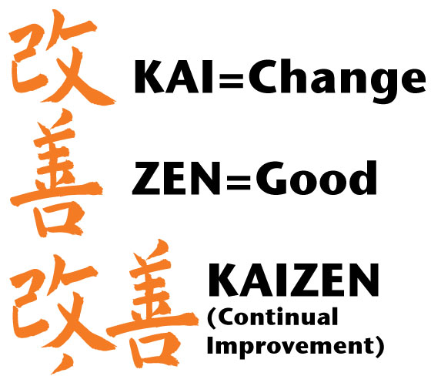
PURPOSE
Kaizen events can be used as a workplace intervention to improve both productivity and safety
Often times when completing a 6S, the improvement team focuses on the reorganization to improve productivity and safety regulations can take a back seat
This PowerPoint is a quick refresher on common safety regulations and hazards to keep in mind when completing a Kaizen event

Slide 3
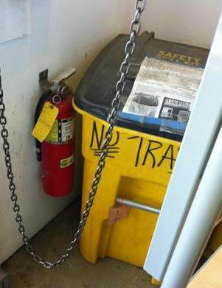



FIRE EXTINGUISHERS
There is a 36” clearance around each fire extinguisher.

Slide 4
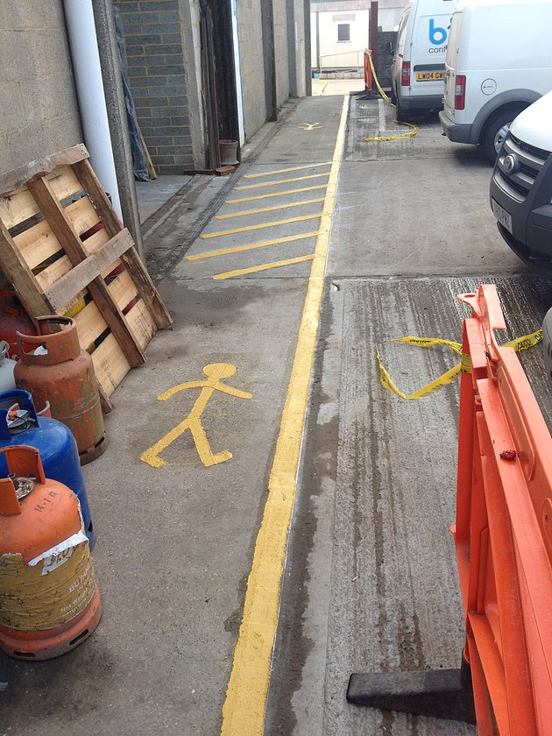
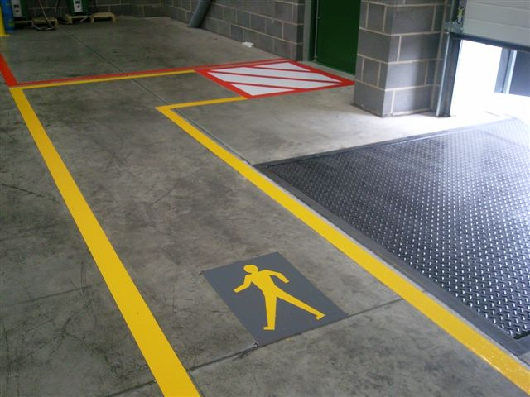
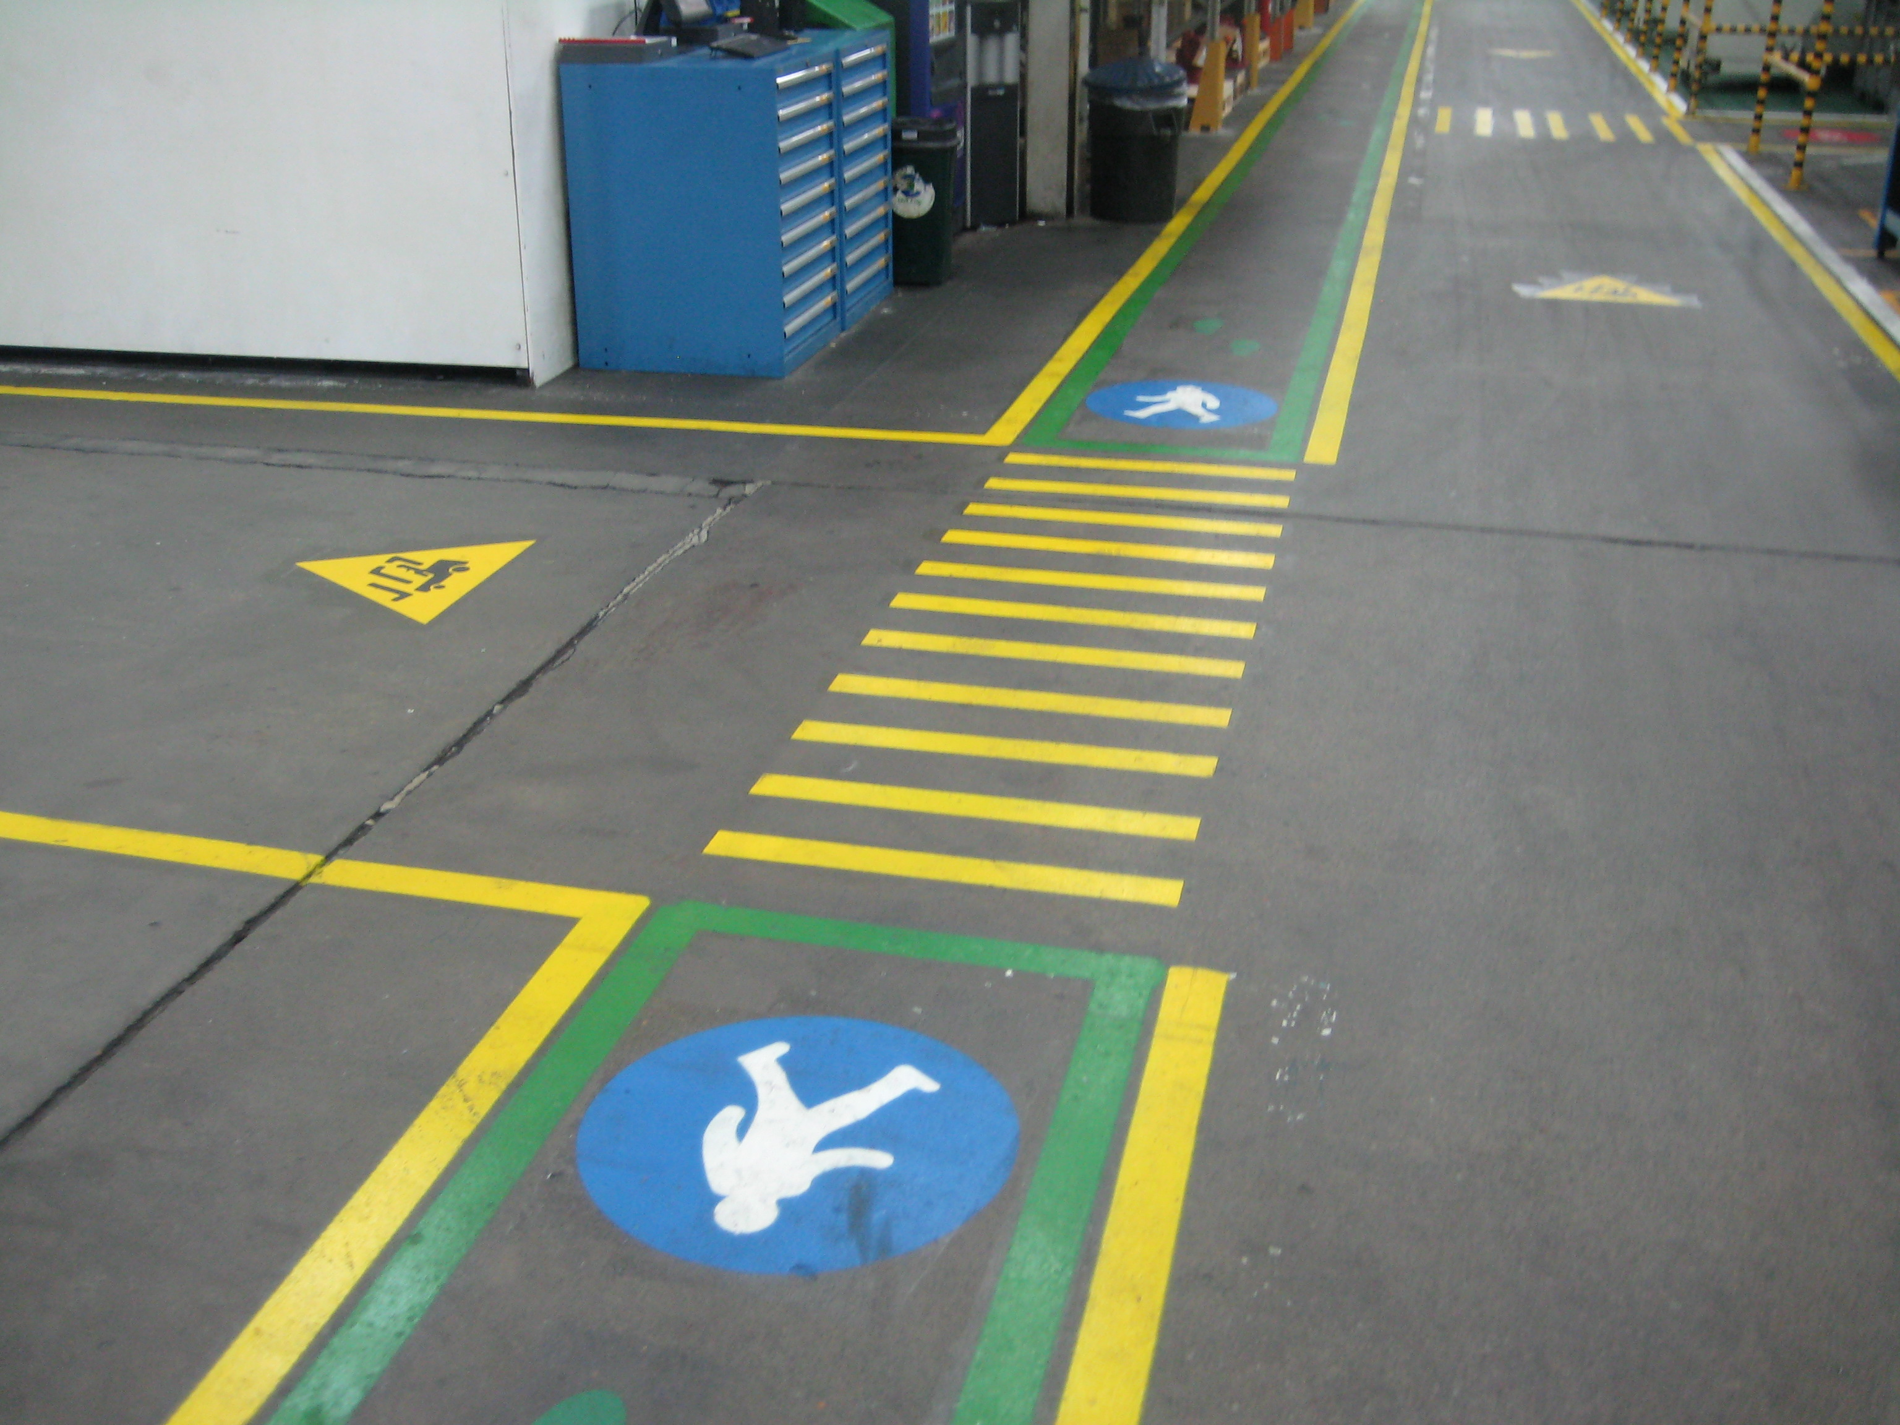
WALKWAYS/EMERGENCY EXITS
Walkways and emergency exit(s) are accessible and workers know the appropriate route.

Slide 5
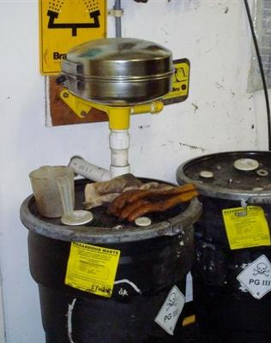
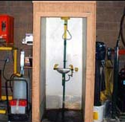
EYEWASH STATIONS
There is a 36” clearance around each eyewash station.

Slide 6
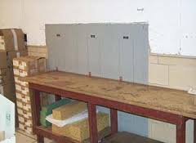
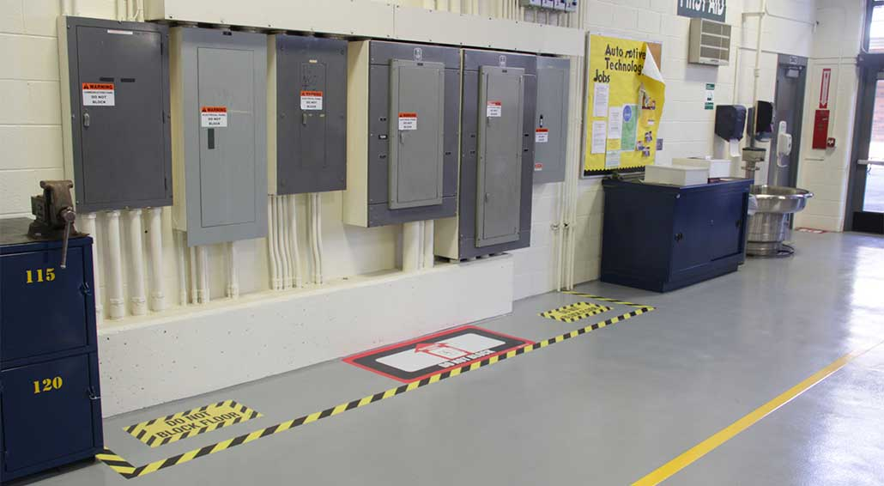
ELECTRICAL PANELS
The front of electrical panels has a minimum of three feet of clearance and a minimum width to be the width of the equipment or 2.5 feet, whichever is greater.

Slide 7
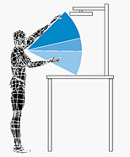

AIR SHUT OFF VALVE
Air shut off point is within reasonable distance for employees: (tables should allow enough space if back to back and must not be too tall)

Slide 8

PHONE/EMERGENCY LIST
There is a phone within reasonable distance from the workstation to be accessed for paging.
The emergency phone list is located near the phone.

Slide 9

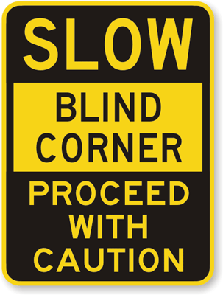
FORKLIFT TRAFFIC
Employees and/or equipment does not interfere with forklift traffic.
Blind corners are equipped with mirrors and/or warning signs.

Slide 10
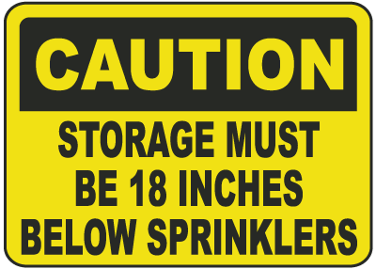
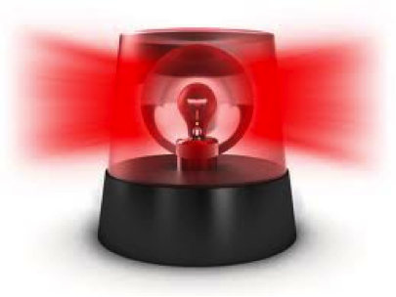
FIRE SPRINKLER/SPEAKERS
  All fire sprinkler heads have at least an 18” clearance below.
  Employees in the workstation are able to hear the speakers/horns (add or relocate speakers if necessary)

Slide 11
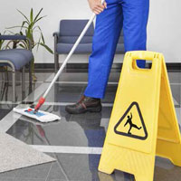
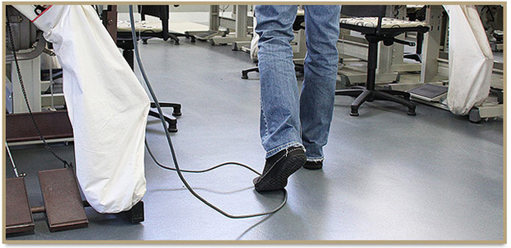
FLOORING/TRIP HAZARDS
All floors are clean, dry, and slip resistant.
Air hose lines and electrical cords are not a trip hazard.

Slide 12
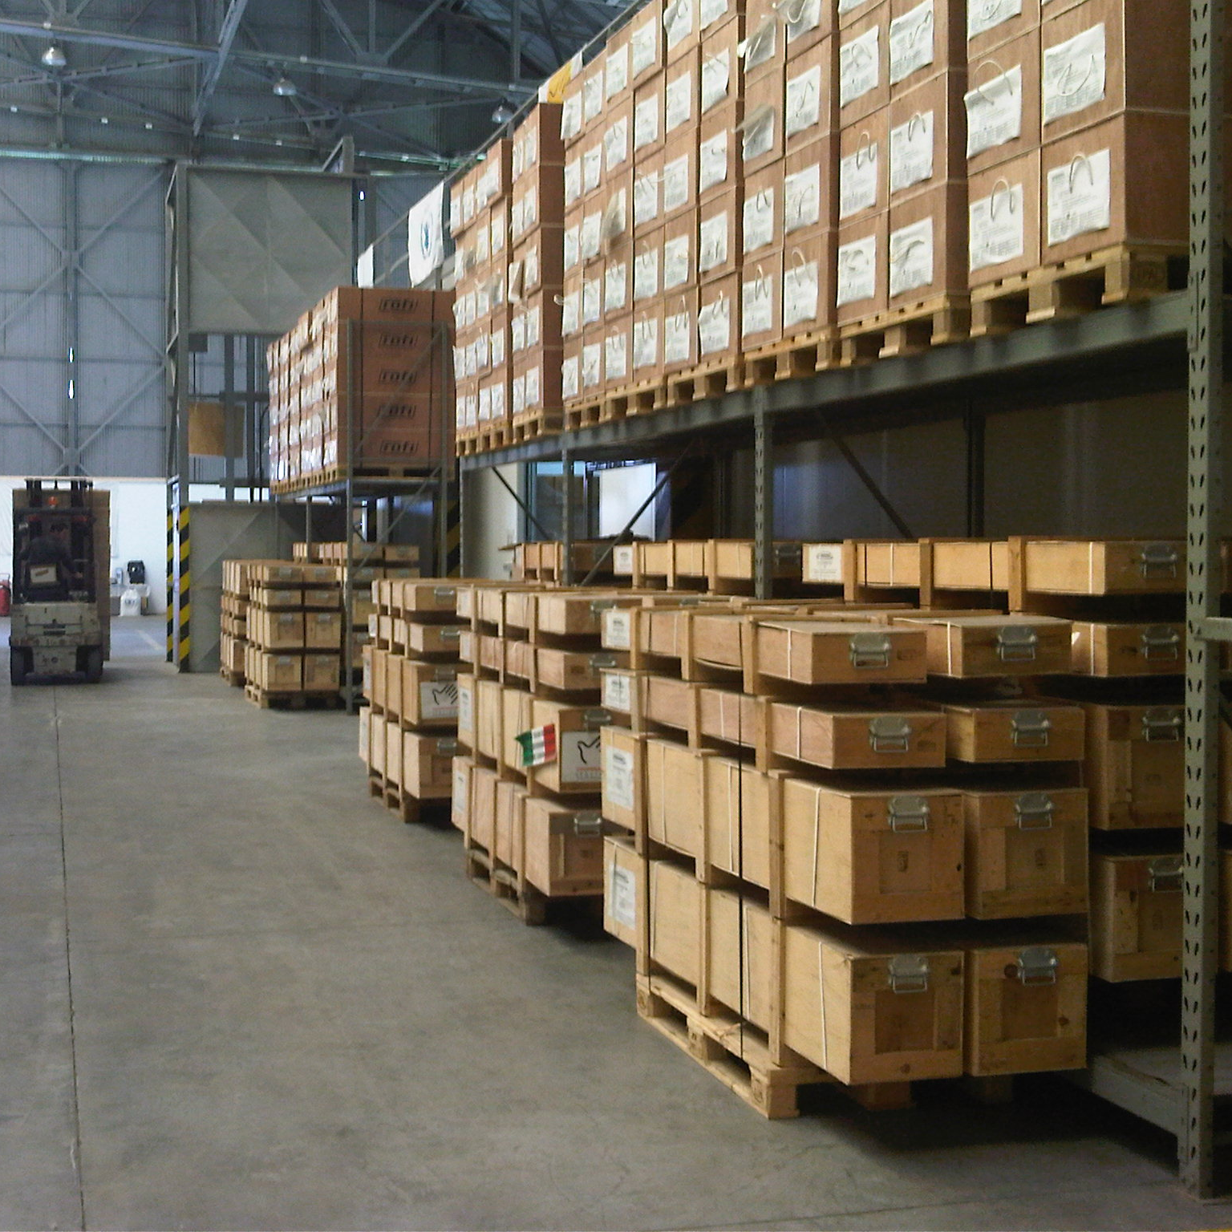
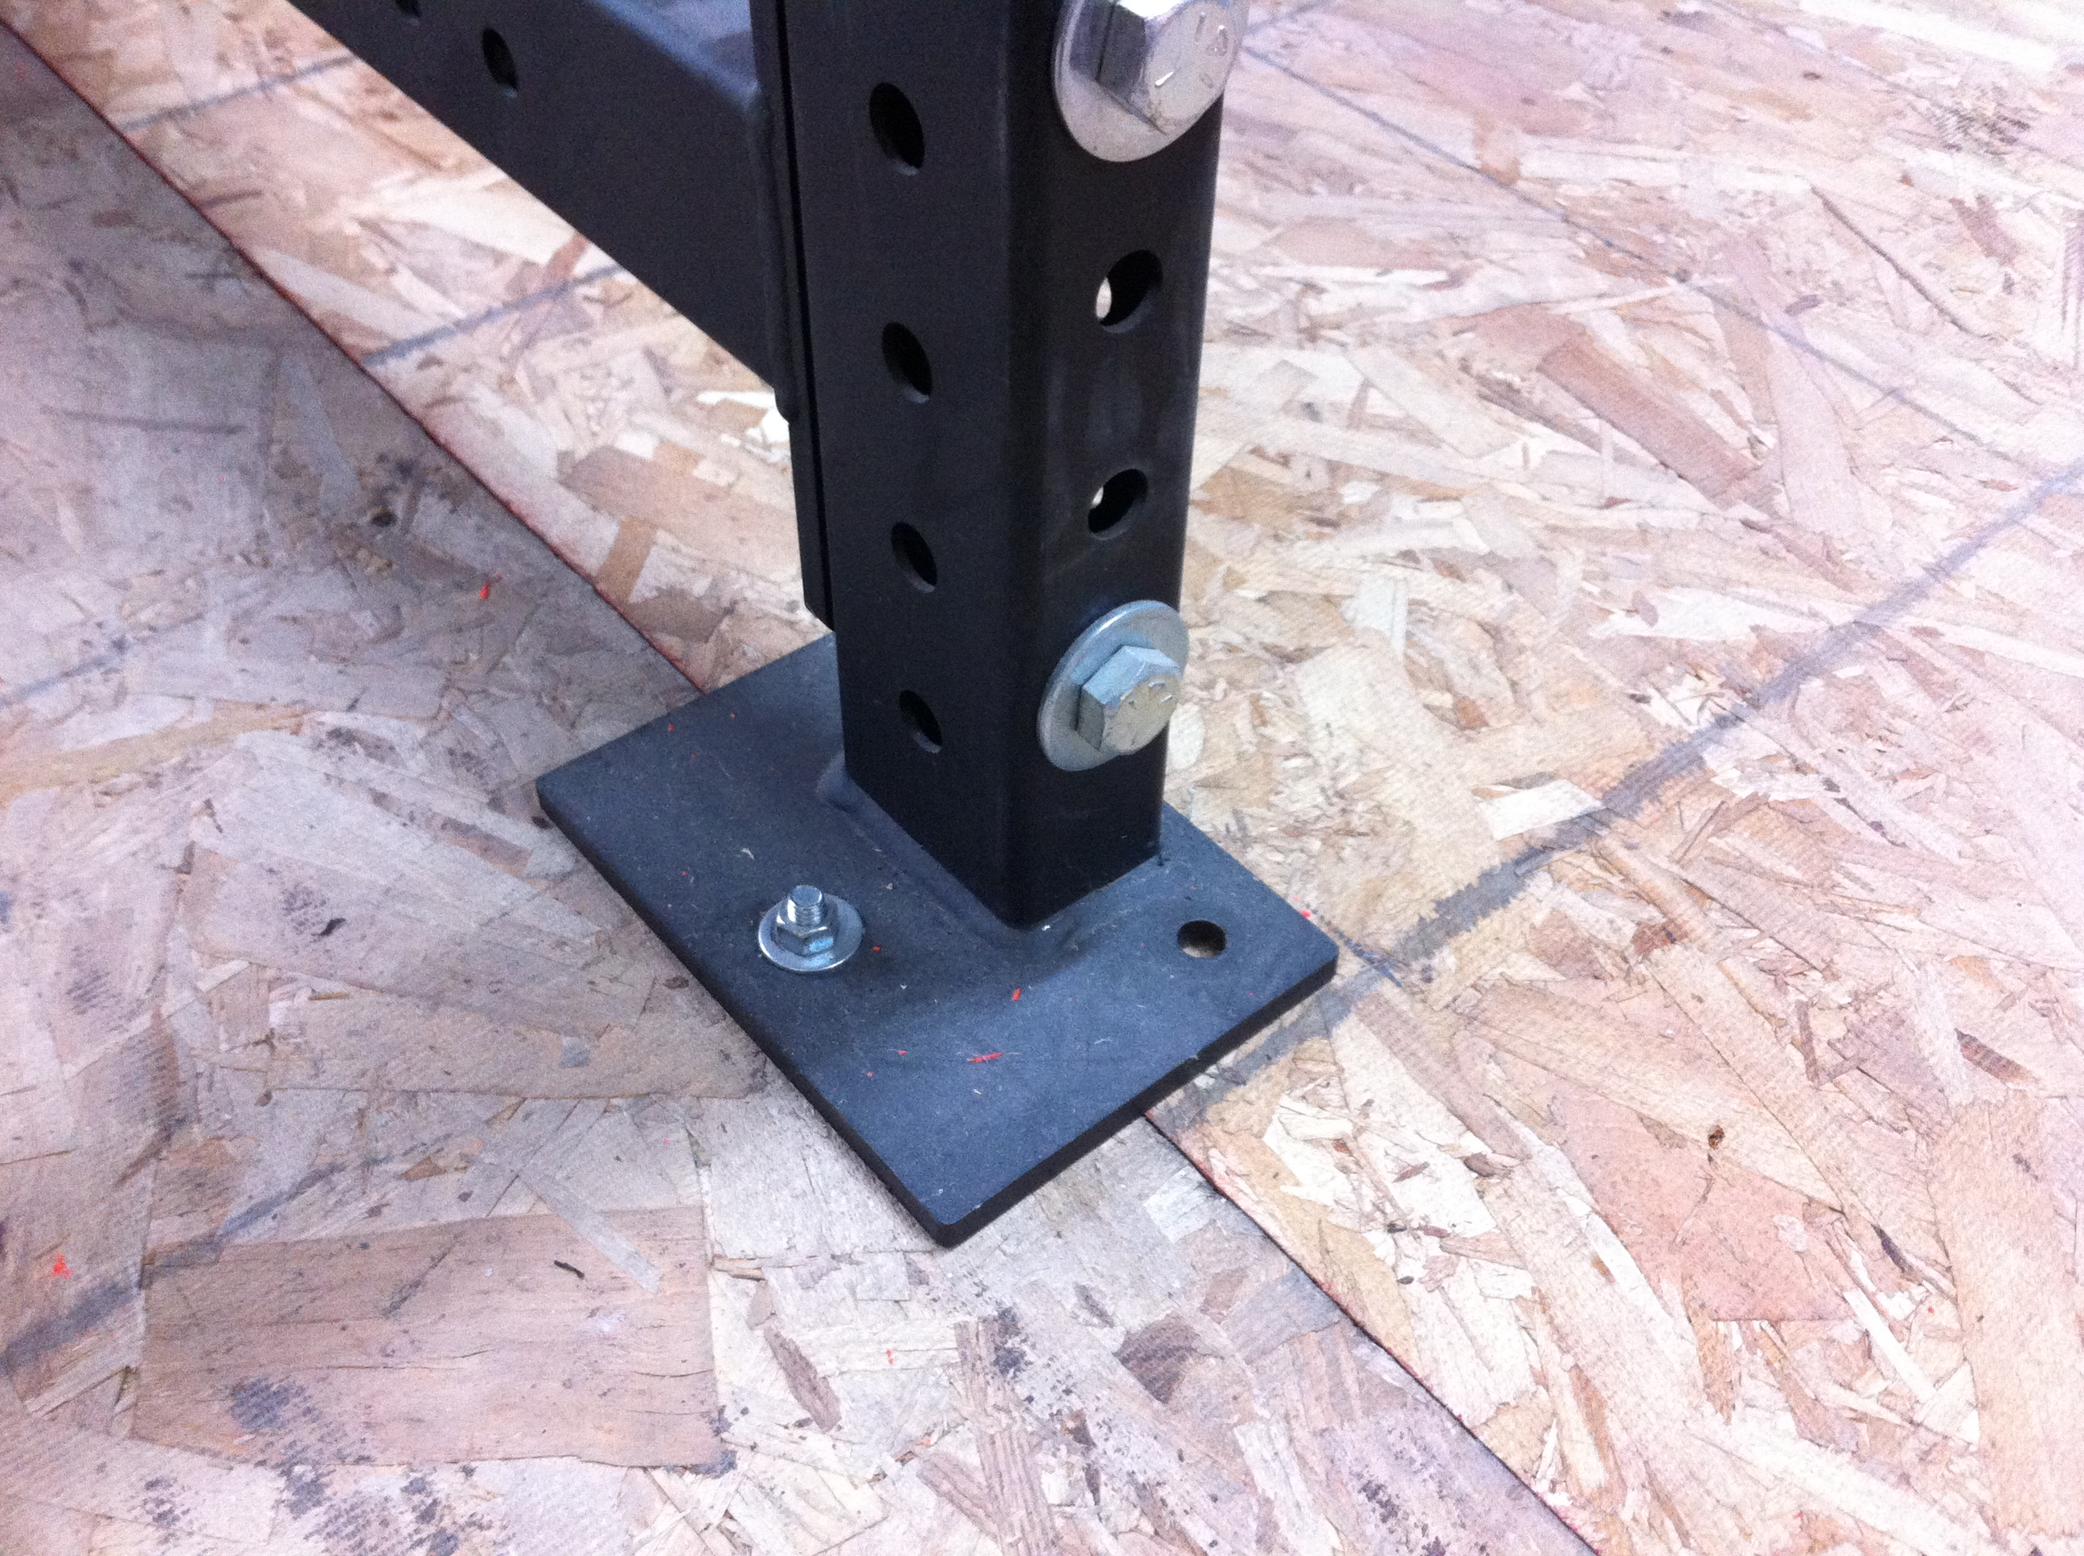
STORAGE/LIGHTING
All storage racks are bolted down to ensure stability.
Site is properly lit

