Slide 1
ASSISTANCE APP V7.0

Slide 2
APP FEATURES

Slide 3
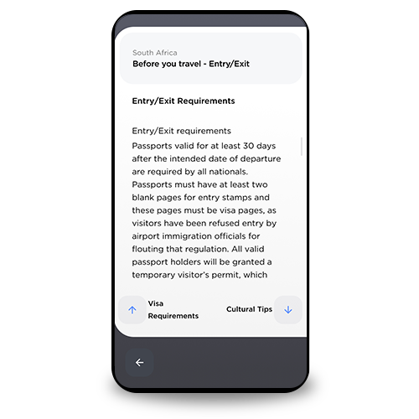
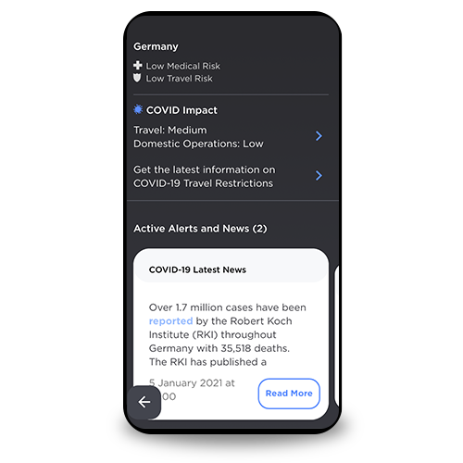
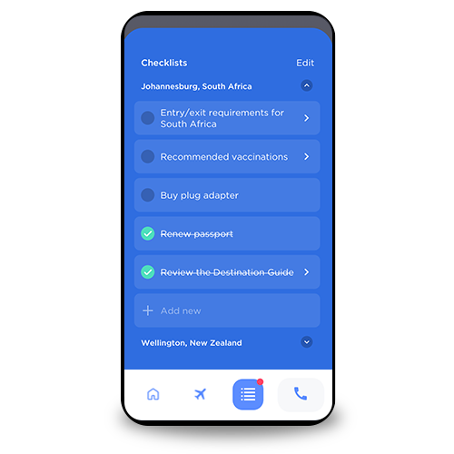
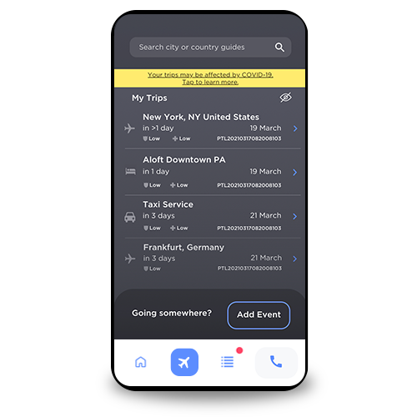
PREPARE FOR YOUR TRIP
ASSISTANCE APP ESSENTIAL TOOL FOR PREPARING, INFORMING AND KEEPING YOUR WORKFORCE SAFE
Vaccination and visa requirements
COVID-19 restrictions and impact
Pre-travel
checklists
My Trips
WORLDWIDE REACH. HUMAN TOUCH.
Notes:
Vaccination and Visa Requirements
Learn what you should know and how to prepare so you can reach your destination and avoid delays when travelling.
COVID-19 Restrictions and Impact
Access tools to help you understand and prepare for the impact of COVID-19 on your next trip.
Explore With Confidence
Planning to go somewhere new? The assistance app gives you everything you need to understand the culture, best practices, and availability of services all over the world.
My Trips
Manage all of your upcoming trip logistics in one place.
Checklists
Our medical and security professionals have created pre-travel checklists to help you prepare for your next trip.

Slide 4
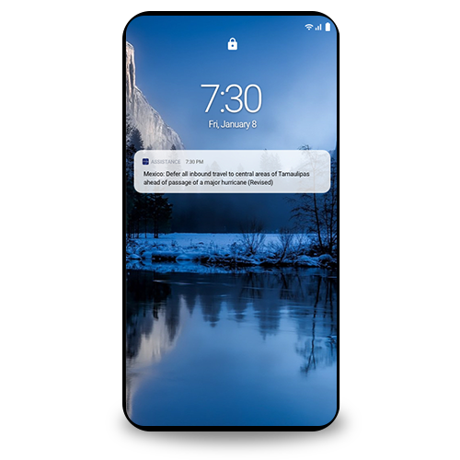
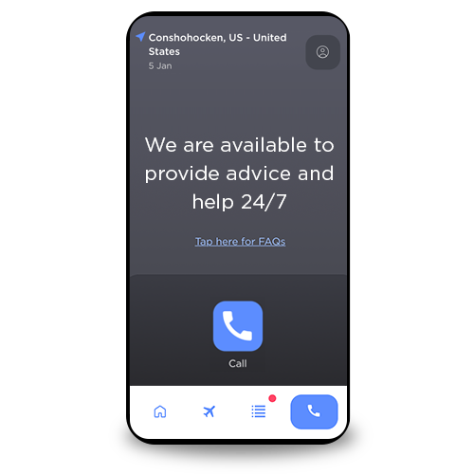
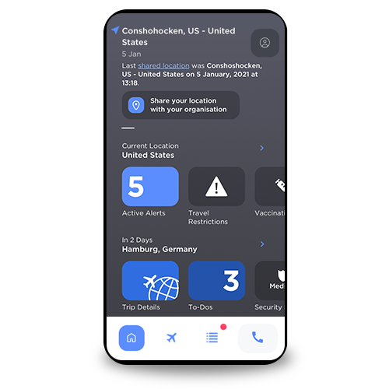
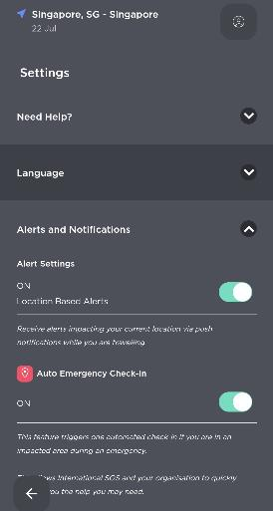
DURING YOUR TRIP
ASSISTANCE APP ESSENTIAL TOOL FOR PREPARING, INFORMING AND KEEPING YOUR WORKFORCE SAFE
Location-based push alerts
Call for 24/7 assistance
Check in
Auto emergency check-in
WORLDWIDE REACH. HUMAN TOUCH.
Notes:
Location-Based Push Alerts
Stay safe in an emergency with location-based alerts. When a medical or security alert is issued for your current location, the App will let you know first via a push notification.
Call or Chat
Have a problem or need advice? Get the help you need 24 hours a day, 7 days a week.
Check In
Want to let your organisation know where you are? Use the app to share your current location with your organisation from your Home page
Auto Emergency Check-In
In cases of a serious security incident, use Auto Emergency Check-In to ensure your organisation knows your exact whereabouts. From the Home page, click on your Profile icon, open the Alerts and Notifications section and switch ON your Auto Emergency Check-In function

Slide 5
GETTING STARTED

Slide 6
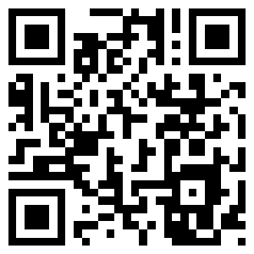
How do I get the app?
OR
Scan this QR Code to automatically open the Assistance App’s download page in your phone’s browser.
Search for “International SOS Assistance App” via iOS App Store, Google Play or App World

Slide 7
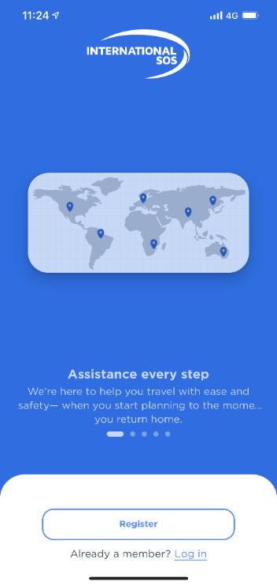
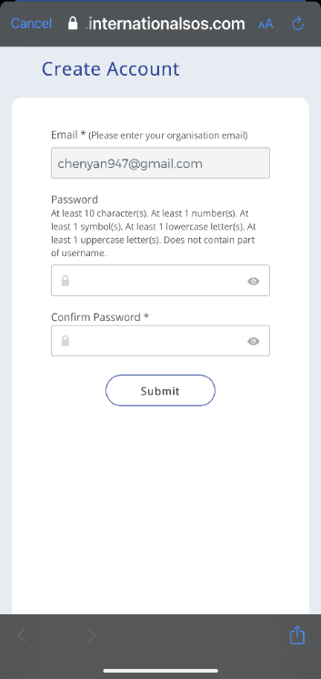
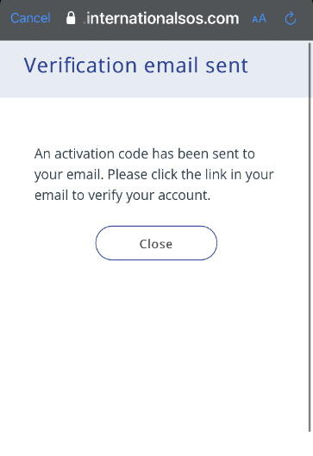
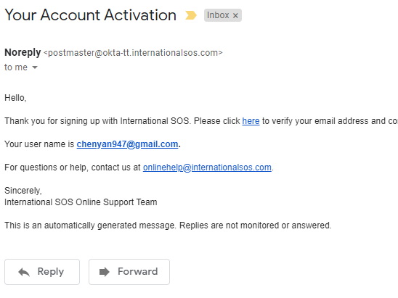
Registration for first-time users Creating an account
You will receive a verification email to the email address you keyed in. In the email, click on “here” to verify and return to the App to Continue
* Enable location services so that the App can identify the nearest Assistance Centre to assist you
Key in your email address and set a password for the app before pressing on “Submit”
Click on Register

Slide 8
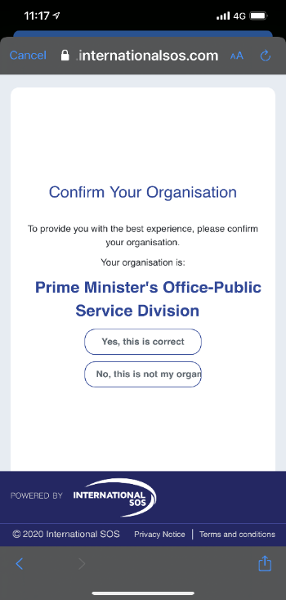
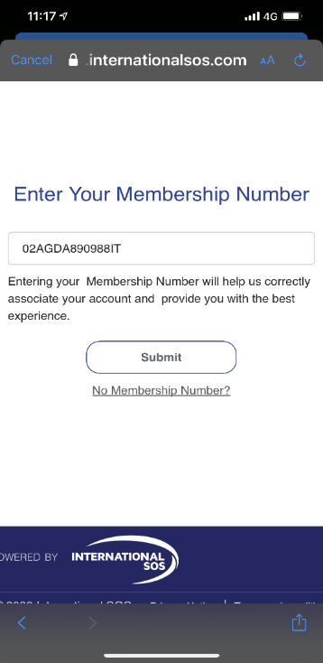
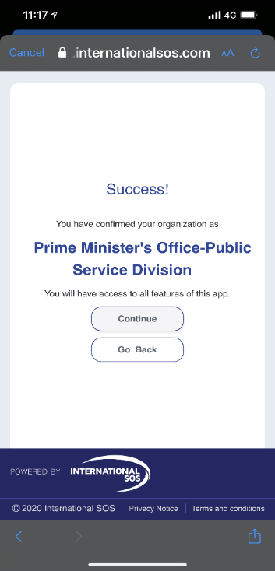
Registration for first-time users Confirming your organisation
[insert number]
[insert client organisation]
[insert client organisation]
Key in your Membership ID and press Submit
Confirm that your organisation name is accurate
Click Continue to proceed

Slide 9
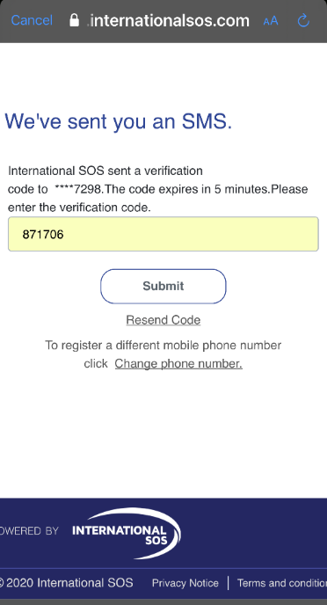
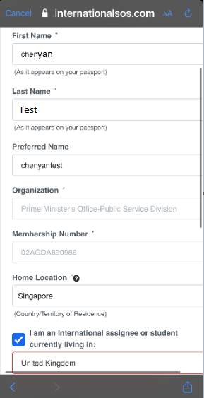
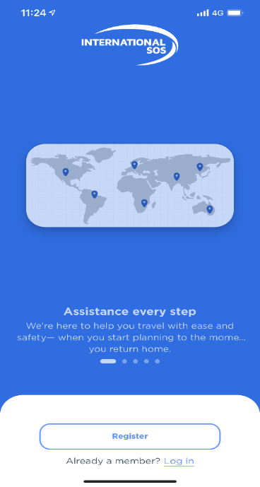
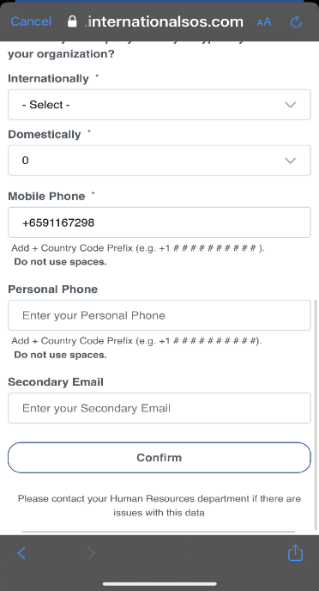
Registration for first-time users Updating your profile
[insert client organisation]
[insert number]
Ensure name fields and preferred name entered is in the same manner as your passport name without any space (Middle name to be included in the first name field)
You will receive a verification code to the Mobile number you provided. Key in the code and click Submit to complete registration
Ensure all information and Mobile are correct and proceed to click on Confirm

Slide 10
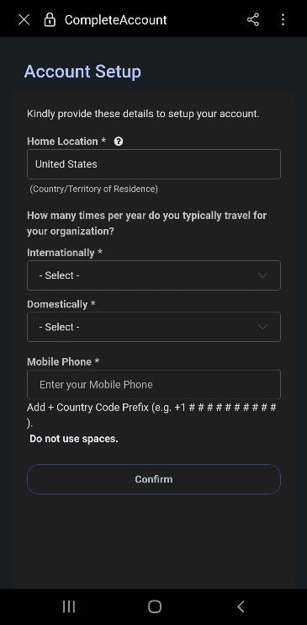
Logging in for existing users Creating a profile for first log in
Click on Log In and register with your existing username & password
Fill up your details and click on Confirm to complete

Slide 11
Logging in for existing users Creating a profile for first log in
Click on Log In and register with your existing username & password
Fill up your details and click on Confirm to complete

