Slide 1
Business Forum
December 13, 2018 9 – 11 AM Baker University Center 240

Slide 2
Agenda
Facilities Partner Group
Procure to Pay Partner Group
Benefits Advisory Council
Key Announcements

Slide 3
Facilities Partner Group
Steve Wood, Associate Vice President for Facilities Management and Safety
April Ritchie, Chief Financial Administrative Officer
College of Arts and Sciences

Slide 4
FY16-FY18 Facilities Partner Group Strategic Goals
Complete SLAs for all three FMS areas
Make SLAs available to community
Define a shared understanding of responsibilities of building contacts
Create building contacts list
Continue to evaluate and implement efficiencies in service

Slide 5
FY19-FY20 Facilities Partner Group Strategic GOALS
Continuation of SLA development for all three FMS areas
Continuation of building coordinators initiative
Improve usage of “reservable” interior space
Decrease operational costs for campus
Increase awareness of space usage
Create list of high visibility buildings on campus and needs for those buildings; investigate “trade-offs” to improve key services to these buildings

Slide 6
Continued development of SLAs
Schedule other organizations for SLA engagement

Slide 7
Building Coordinator initiative NEXT STEPS
Maintain updated list of contacts for all buildings
Communicate purpose and goals to all contacts
Ask for feedback and suggestions
Schedule building contact training
Best practices for work orders
Report Generation
FMS ongoing Initiatives and KPI

Slide 8
Review and consider revisions to facilities usage policies
Identify all facility usage policies
Review how space is used and how space should be used
Identify areas where we can implement transparency and cost savings

Slide 9
High visibility buildings on campus
Identify high visibility buildings
Identify gaps in services needed inside and outside of those buildings

Slide 10
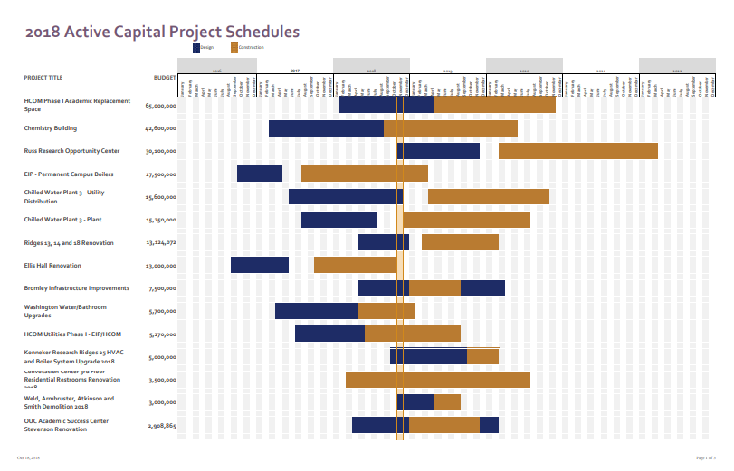

Slide 11
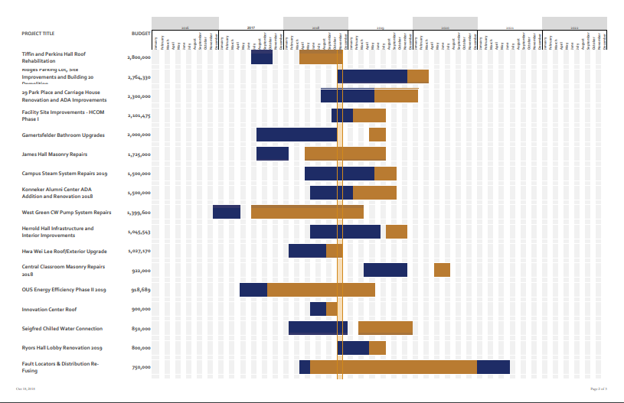

Slide 12
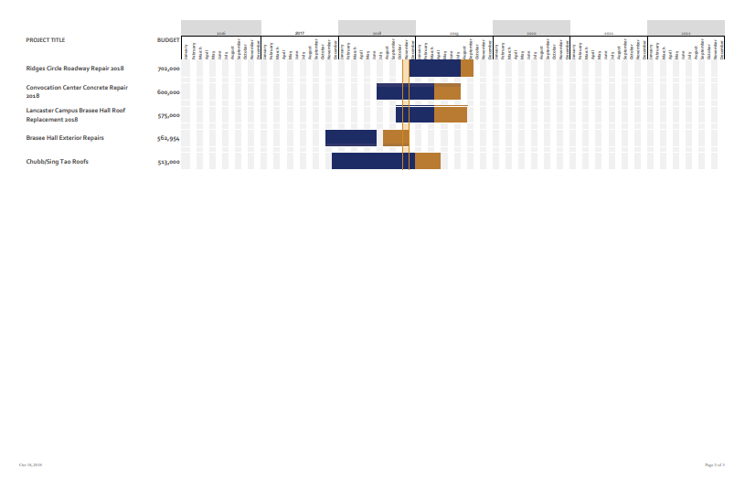

Slide 13
Procure to Pay Partner Group
Julie Allison, Associate Vice President for Finance
Kelly Broughton, Assistant Dean for Research and Education Services, University Libraries

Slide 14
Procure to Pay Partner Group Agenda
Partner Group
Membership
Charge
Goals
Travel Provider Update

Slide 15
P2P Representation
Julie Allison, Finance and Administration, Co-Chair
Kelly Broughton, University Libraries, Co-Chair
Diane Cahill, Office of Global Affairs & International Studies
Wayne Chiasson, Physics and Astronomy, College of Arts and Sciences
David Ingram, Physics and Astronomy, College of Arts and Sciences
Kelly Coates, Heritage College of Osteopathic Medicine
Kim Hayden, Regional Campuses
Heather Krugman, Scripps College of Communication
Keith Leffler, Research and Sponsored Programs
Becky Maccombs, Russ College of Engineering
Erin Robb, Culinary Services (Auxiliaries)

Slide 16
Procure to Pay (P2P) Partner Group Charge
Develop solutions to improve policies, processes, and communications between planning units and the Purchasing & Payments department of the Division of Finance
Gather feedback, review recommendations, and assist in the prioritization of issues related to university operations centered on purchasing and payments, including contract and insurance services, travel, PCard, and suppliers

Slide 17
P2P Partner Group 2019 Goals
Review and update University policies and procedures to align with best practices as well as state & federal regulations for:
Purchasing
Competitive bidding
Travel
PCard
Advise and provide feedback on the development of training and communication strategies for university faculty and staff on policy and procedures within the scope of the partner group

Slide 18
Travel Update

Slide 19
New TMC is….
Christopherson Business Travel (CBT)
Higher Education & Group Travel experience
24-Hour Service
Simplified and reduced pricing structure
Dedicated Travel Advisors to OHIO account
Modern and streamlined payment options

Slide 20
Travel Services – Why Now?
Current Travel Management Company (TMC) not meeting needs (pricing, service, etc.)
Outdated policies that don’t align with practices
Better compliance with federal mandates for travel (e.g. Fly America)
Governor’s Affordability & Efficiency Mandate: Travel
University traveler must book through TMC using Concur or Agent

Slide 21
Setting Expectations
Mandated use of TMC
Getting past the previous TMC experience
Booking through Concur
Significant reduction of purchasing cards
Travel booked prior to transition

Slide 22
Travel Policy Discussion Items
Travel Services Working Group (TSWG)
Reviewing DRAFT policy
Pre-approval
Discussing economy fares allowable/not allowable
Mixing business and personal travel
Conference hotels
Meals and Incidentals
Payment options – airline, hotel, rental car

Slide 23
Travel Recommendations Workflow
Traveler Focus Groups
Travel Work Group
P2P Partner Group
RC Strategy
Project Sponsor/Steering Committee

Slide 24
Campus Feedback and Involvement
February ‘18: Key pain-points identified in campus survey
More expensive than online (Fees and options)
Lack of confidence/trust due to negative experience with current TMC
Online tools are easier and more convenient
Not aware online booking tool existed
December ‘18: Faculty and Researcher Focus Groups
Coordinated and communicated through Faculty Senate
December ‘18 – ‘19: Staff Feedback
One-on-one meetings with frequent travel bookers and staff travelers
Identified by CFAOs
December 2018– January 2019: Group Feedback
Large group and specialty travel
Advancement, OGAIS, Athletics, Student Affairs

Slide 25
Change Management Strategies
January 2019: Travel web page (ohio.edu/travel)
Communication links
FAQs
Quick Reference Guides/Job Aids
Regular communication to campus – about every two weeks
E-training program (individual and group travel)

Slide 26
Travel Manager Position
Dedicated Travel Manager
On Site – Athens Campus
Christopherson Business Travel (CBT) Employee
Currently recruiting for position – estimated start date January 2019

Slide 27
Project Scope and Tentative Timeline
January 2019: Concur Upgrade
April 1, 2019:
Updated Travel Policy and Procedures
Christopherson Implementation and Reconfigure Online Booking Tool in Concur
Updated PCard Policy & Procedures
Duty of Care
Gathering draft business requirements

Slide 28
Tentative Rollout Schedule
4/1 Go-Live
November
December
January
February
March
April
Policy Draft & Review
Project & Change Planning
Business Decisions
Concur Expense User Interface Upgrade
Policy Approval Concur Configuration
Updated Policies
TMC & OBT
Training Development
User Feedback Gathering, Socialization, Planning Unit Meetings, OEN Articles, Direct Email
E-learn Training: Concur Expense
Policy Training
Individual Travel
Group Travel
Go Live Support Open Forums Live Training
Communication & User Guide for Concur Upgrade
Planning & Development
System &/OR Policy Launch
Campus Support

Slide 29
Travel Project Steering Committee
Executive sponsorship to provide guidance and resolve escalated issues

Slide 30
Travel Project Work Group
Planning Unit | Representative(s)
Advancement | Bo Richardson
Arts & Sciences | Nukhet Sandal Wayne Chiasson
Athletics | Tim Knavel Tami Escue
College of Business | Evelyn Blake Phillip Taylor
College of Communication | Kelsea Bolin
College of Fine Arts | DeAnna Russell
College of Engineering | Shannon Bruce Shawn Ostermann
College of Medicine (HCOM) | Greg Jolley
Health Sciences & Professions | Tia Barrett
Finance | *Sue Jago
Global Affairs & International Studies | *Catherine Marshall
Regional Campuses | Kim Hayden
Student Affairs | April Crabtree
Voinovich | Cynthia Chapman
Charge:
The purpose of the Travel Services Work Group is to support the travel project by providing University perspectives and recommendations as it relates to University policy, procedure, tools, and engage in change management activities. The TSWG will also serve as a point of contact to gather feedback and share communication about the project.
*Work Group Co-Chair

Slide 31
Points of Contact
travel@ohio.edu
Travel Services Work Group

Slide 32
Questions?
Julie Allison, Associate Vice President of Finance
allison@ohio.edu
Kelly Broughton, Assistant Dean, University Libraries
brought@ohio.edu

Slide 33
Benefits Advisory Council Update
Benefits Advisory Council (BAC):
Charged with analyzing and make recommendations regarding university benefits while considering financial sustainability, competitiveness, and fairness.
Members include Administrative Senate, Classified Senate, Faculty Senate, as well as a Dean, Vice President, the Chief HR Officer, an Academic Chair/Director, an Associate Provost, etc.
Guiding Principles include:
Eliminate structural deficits
Avoid Affordable Care Act Cadillac Plan Tax (required by state law)
Establish a maximum university contribution to the annual inflationary cost of benefits (no more than 5%)
Previous recommendations have included a mix of premium increase, cost sharing increases, consumerism, wellness, and improving benefits such as vision and dental plans.

Slide 34
Benefits Advisory Council Update
The BAC has established a three-year recommendation pattern.
Recommendations are reviewed each year and adjusted/updated as needed.
The existing three year recommendation included FY20 changes to the employee premium percent and co-insurance maximum, and changes to the deductible, and co-insurance maximum for FY21 and FY22
The BAC has recommended these scheduled changes be delayed by one year, and that reserves be used to ensure the FY20 budget remains at or below the 5% goal.

Slide 35
BAC Recommendations
Options | FY18 | FY19 | FY20 | FY21 | FY22
Deductible | $500/$1000 |  |  |  | $700/$1400
Co-Insurance Maximum | $2000/$4000 |  |  | $2500/$5000 | $2550/$5100
Out of Pocket Maximum | $2500/$5000 |  |  | $3000/$6000 | $3250/$6500
Co-Insurance %
Office Visit Copays
Rx Retail Copays
Rx Mail Copays
Premium | 15%-17.5%20% |  |  | 17%-19%-21%
Other | Rx Advanced Utilization Review HMO Plan Elimination | Dependent Verification Plan Savings Use of Reserves ($900K) | Use of Reserves

Slide 36
BAC ongoing/future discussions
Attempt to move from premium/cost sharing changes to other options
RFP for Anthem and/or Express Scripts Contract
Consortium opportunities (IUC or elsewhere)
High Deductible Health with Health Savings Accounts
Targeted care management programs
Narrow provider network
Cost/Quality transparency tools
Etc.
Impact of Affordable Care Act Cadillac Plan Tax on Faculty/Staff plan and AFSCME plan
Possibility of combining plans and subsequent impact

Slide 37
Human Resources Website Redesign

Slide 38
Current State Assessment
Survey sent out to faculty and staff in July
519 Responses (401 Staff, 118 Faculty)
Top 5 most important
Who to contact for info: most important and most difficult to find
Benefits details
Forms: page was easy to find but finding the correct form was difficult
System Access
Policies
Areas of improvement
Unclear and confusing navigation
Too much content to sift through
More standard language
Better guidance for supervisors
Difficulty finding correct form

Slide 39
Focus Groups and New Navigation
July – August: Card Sort Focus Group and Tree Sort
New Navigation
My HR Info
Jobs at OHIO
Hire and Manage
Benefits
Compensation and Pay
Resources

Slide 40
Website Launch Details
New site scheduled to launch on January 7, 2019
Forms: Searchable table with descriptions and forms will meet accessibility standards
Clearer instructions regarding who to contact
Self Service, Employee Service Center, HR Liaisons
Links to login pages of HR Systems and Benefits sites
Redirects will be in place for six months (check your bookmarks)
If you manage a website, check links to HR site after January 7, 2019

Slide 41
Compensation Updates
Biennial Equity Review
5 Year Market Study

Slide 42
Biennial Equity Review
This review is required as part of the resolution agreement signed with the Department of Education.
4th Equity Review since COMP 2014.
First two reviews used compa ratio model.
Third and fourth use regression model process with outside professional consultant.
Purpose:
Ensure that employee compensation has been determined on a non-discriminatory basis.
Evaluate that pay equity is in compliance with Office of Federal Contract Compliance Programs (OFCCP) standards.

Slide 43
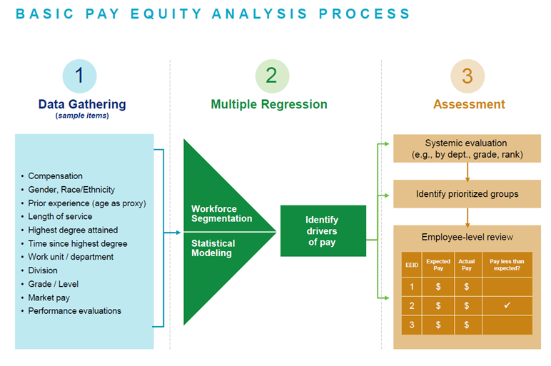
Biennial Equity Review

Slide 44
Biennial Equity Review
Timeline
June 2018 - Issued RFP
July 2018 - Selected Vendor
September2018 - Kick-off Meeting & Data Gathering/Regression Analysis
November/December 2018 - Analysis Review
December/January 2018 - Communicate with Planning Units
Mid-Late January 2019 - Communicate with Impacted Employees
Late January 2019 - Process Equity Adjustments (if applicable)

Slide 45
5 Year Market Study
Utilizing a professional consultant, review existing jobs within our framework against updated market information.​
Review Pay Administrative Guidelines and Compensation processes (includes surveys used) against industry best practices.
Identify benchmarks that have changed and update pay grades (re-slotting).​
Base wage adjustments will be required if a job re-slotting results in the incumbents pay falling below the paygrade minimum.

Slide 46
5 Year Market Study
Timeline:
Oct. 2018 – RFP Issued
Dec. 2018 – Vendor Selection
Jan. 2019 - Kick-off Meeting​
Feb. – Oct. 2019 - Data Gathering/Analysis/Consultation​
Nov. 2019 – Update benchmarks and framework as needed​
Dec. 2019 - Communicate with Planning Units/Impacted Employees​
Jan. 2020 – Employee pay adjustments to new minimums as needed

Slide 47
Questions?
compensation@ohio.edu

Slide 48
Professional Development updates
TAC Structure Update
Professional Development Pathways Update
New Certificate
Questions

Slide 49
Training Advisory Council Charge
Provide insight and guidance to support the following:
Institutional support for training and development
Elimination of systemic barriers to development
Creation of a robust structure to implement a sustainable environment for training and development
Consistent, positive and professional training and development experiences aligned with our desired culture
Methods and resources for those new to their position
Leveraging collective resources and expertise from around the university to support professional development

Slide 50
Representation
Co-Chairs
Amanda Davis, Change Management & Communication
Lewis Mangen, Organizational & Talent Development
Administrative Senate
Wendy Rogers, University College
Eileen Theodore-Shusta, Ohio University Libraries
Classified Senate
Cheri Sheets, Geological Sciences
Sharon Romina, Cutler Scholars Program
RC Strategy
Phil Taylor, College of Business
Kari Saunier, College of Fine Arts
Thank You!!

Slide 51
Training Advisory Council – New Structure
Professional Development Leadership Review Panel
Senior leadership from major organizational units
Review progress and effectiveness of professional development programs
Provide guidance and direction on future training needs for the university
Training Advisory Council
Cross-functional classified and administrative employees, membership updated annually
Charge remains the same as current
Provide insight on current training needs, priorities, and obstacles
Participate in design and vetting of PDP courses
Certificate Development Team
Additional employees work with TAC to provide expertise for specific certificates
Temporary assignments to assist in developing and vetting course content

Slide 52
Professional Development Pathways - Update
Accounting Certificate
Purchasing Certificate
HR Operations Certificate
Available Courses
Cash Handling & Credit Card Awareness
Chart of Accounts Fundamentals
Grants Accounting Fundamentals
Internal Awards
Coming Soon
OBI Reporting Fundamentals – Jan., 2019
Approvers of Financial Transactions – Jan., 2019
Cost Share – TBD
Distributed Journal Entries – TBD
Foundation & Endowment Accounting - TBD
Available Courses
BobcatBUY Fundamentals
Chart of Accounts Fundamentals
Grants Accounting Fundamentals
Coming Soon
OBI Reporting Fundamentals – Jan., 2019
Approvers of Financial Transactions – Jan., 2019
Preferred Supplier Purchasing – TBD
Foundation & Endowment Accounting - TBD
Concur Expenses – March, 2019
PCard Policies & Processes – March, 2019
Booking Group Travel – March, 2019
Booking Individual Travel – March, 2019
Goal: Improve knowledge and skills associated with HR processes, systems, and operating environment.
High-level HR Overview
Introduction to key HR functions
High-level info and contacts
Key content areas:
Recruiting & Hiring
Payroll & Taxes
Employee Benefits & Retirement
Employee Services & Resources
Performance Management

Slide 53
Human Resources Operations Certificate - DRAFT
Human Resources
Recruiting and Hiring
Employee Services & Resources
Payroll, Taxes & Timekeeping
Professional Development
Performance Mgt.
Compensation
Benefits
Workers’ Comp & Care Mgt.
Employee and Labor Relations
Human Resources Overview Course (e-learn)
Welcome
Short introduction to each content area (1-3 slides, 3-5 min)
User selects which area(s) to explore
Some content areas link out to additional courses
Include staff contact info (need to keep updated)
Course is not complete until all areas are explored
Recruiting and Hiring Courses
Hiring Processes, Plans & Options
Search Committees 1
Search Committees 2
On-boarding
Job Postings
People Admin
I-9 Compliance
Employee Benefits Courses
Benefit Offerings
Retirement
Leaves of Absence
EAP and Wellness
Misc. Benefits (Title?)
Payroll and Taxes Courses
Workforce – time entry & reporting
FLSA
ICD
Admin Tax Treaty, NRA’s
EE vs. IC Determination
Employee Services & Resources
ESC & HR Liaison Roles
Employee Resources & Involvement
New Hire Paperwork
Self Service (MPI & Benefits)
Performance Mgt. Courses
Performance Mgt. - non-supervisors*
Performance Mgt. Overview*
Performance Feedback & Coaching
Performance Evaluation & Recognition
Other Courses
Workers’ Comp - Care and Claims
Compensation framework
HR-related legal env. (title?)
Non-Payroll related taxes
* One of these Perf. Mgt courses is required

Slide 54
News and Announcements
Office of Instructional Innovation providing instructional design support
Preparing RFP for “off-the-shelf” e-learning provider
Updated professional development policy to be discussed at ESPC meeting
Blackboard will not be available for PDP courses from December 19-26
New HR Learning Lab to be established in HRTC 154

Slide 55
Questions?
Questions for you:
What HR processes or tasks do you deal with as part of your job?
What would you like to learn about these processes in order to do your job better?
Questions for us:
General Questions – Employee Service Center, uhr@ohio.edu
Course Enrollment and Badges – Melissa Weaver, weaverm1@ohio.edu
Blackboard – OIT Help Desk, (740) 593-1222 or servicedesk@ohio.edu
Lewis Mangen, (740) 593-1627 or mangen@ohio.edu

Slide 56
Finance updates
Julie Allison, Associate VP for Finance

Slide 57
Winter Break Closure (WBC) Deadlines
Date | Time | Item Due
December 12, 2018 | 3:00 p.m. | PCard applications due for card delivery before WBC. Cards may be picked up through 5:00 p.m. on December 24, 2018.
December 14, 2018 | 5:00 p.m. | All necessary forms and information must be received from supplier for setup.
December 14, 2018 | 5:00 p.m. | Any invoices that need to be paid in the final check run before break are due to Accounts Payable, accounts.payable@ohio.edu. Invoices will be paid in January if received after this date.
December 14, 2018 | 5:00 p.m. | Requisitions for purchase orders needed. Requisitions for software, new contracts, or purchases over $50,000 may require additional review time.
December 19, 2018 | 5:00 p.m. | Concur reports must be through the departmental approval stage for reimbursement.

Slide 58
Winter Break Closure (WBC) Deadlines
Date | Time | Item Due
December 19, 2018 | 2:00 p.m. | Student Payment Release Forms must be received by the Bursar Office (last student refund is December 20, 2018)
December 24, 2018 | 10:00 a.m. | Last check run before closure. Next check run will not take place until January 3, 2019.
December 24, 2018 | 3:00 p.m. | Deposits must be delivered to the Bursar window to be processed.
December 24, 2018 | 5:00 p.m. | Last day to pick up PCards before closure.
The University is officially closed for business on Tuesday, December 25, 2018 and Tuesday, January 1, 2019. During WBC, the Finance Customer Care voicemail and email box will be monitored for emergency only issues (financecustomercare@ohio.edu or 740.597.6446). Business days during WBC (December 26-28 and December 31), mailboxes will be checked twice a day to address emergency only issues. Normal business needs will be addressed when the University officially opens for business on Wednesday, January 2, 2018.

Slide 59
Cost Share Award Process
Sponsored Awards that require Cost Share:
Cost share represents the portion of costs not paid for by the sponsor.
The following types of cost share must be tracked and require a cost share account to be set up:
Mandatory: required per grant award and reported to sponsor
Voluntary Uncommitted: not required by sponsor but in proposal or budget therefore must be tracked
Program Income: fee income from registration fees that must be tracked
Cost share account (PTA) will be set up same time as Sponsored account (PTA) by Grants Accounting
Grants Accounting will email Principal Investigator the cost share account number and request account number to fund cost share award
Grants Accounting completes journal entry:
Debit departmental account using object code 630300 FUNDING TRANSFERS COST SHARE.
Credit applied to cost share account
Principal Investigator ensures cost share expenditures are being charged to cost share account
Grants Accounting is working with departments to setup awards

Slide 60
Effort Reporting Update
Ohio University’s reporting periods for effort certification are:
Fall Semester August 16 – December 31
Spring Semester January 1 – May 15
Summer Semester May 16 – August 15
Summer FY 2019 Effort Certification due to Grants Accounting Office no later than 5 PM on Tuesday, December 11, 2018
Fall FY2019 Effort Certification will be released in April 2019

Slide 61
Micro-purchase Threshold (MPT) Limit Changed
Effective November 13, 2018
MPT level is $50,000
Aligns with normal purchasing process
Uniform Guidance questions have been removed from BobcatBUY effective Friday, November 16, 2018

Slide 62
Out of State Sales Tax
South Dakota vs. Wayfair, Inc.
Each state will determine a revenue and transaction threshold limit
Requires all out of state retailers to collect and remit sales tax in each state the threshold is met
Impact to Ohio University – any department making sales outside of the State of Ohio
More info coming in January 2019
Robert Payne, Tax Manager
593-1721
payner1@ohio.edu

Slide 63
Internal Vendors & Guests Forms
New Forms Support Payments to International Vendors and Guests
Foreign Source Affidavit – replaces the W-8BEN (E) for vendors who will perform services from another country.
Honorarium or Travel Reimbursement Affidavit – used for international visitors that will visit an Ohio University campus and receive an honorarium or travel reimbursement.
If receiving an honorarium payment the affidavit should be used along with a completed W8BEN
If receiving travel reimbursement in accordance with the accountable plan rules, the affidavit may be used alone

Slide 64
Accounting Update
Petty Cash and Change Fund Responsibilities
Remember to submit petty cash change fund request form and reconciliation form any time responsible employee(s) changes
An email will be sent out to Custodian, Backup Custodian or Fiduciary of a Petty Cash Fund or Change Fund mid-December to verify responsibilities
Holiday Expenditures
Holiday parties or decorations cannot be purchased with University or Foundation funds
Gifts can only be purchased with Foundation funds with proper approval of the VP for University Advancement
Foundation funds can only be used to send cards to external entities who have a business relationship to the University
https://www.ohio.edu/finance/business-matters/news/holiday-expenditures

Slide 65
OBI Finance – Dashboard Changes
Grants Award Summary Dashboard
Added prompt for Award Category
Equipment Inventory Dashboard
Added the Org Parent Level and Org Parent #/Desc prompts, so report can be run for all levels of the Organization Hierarchy
Previously could select either individual org or total planning unit

Slide 66
OBI Dashboard – Future Changes
OPEN ISSUE: Source Segment Lookup
Not all users are able to drilldown to OnBase guidelines
OnBase team is hoping to have resolved over the next month
COMING SOON: GL Funds Available
At the request of the Accounting & Reporting Partner Group, the default View Selector is being changed to Traditional View, rather than Revenue/Expense View
This change will not affect saved customizations
For users who prefer Revenue/Expense View, you can save that as your default customization

Slide 67
Payroll Forecasting Dashboard
Payroll Forecasting page added to the HR dashboard shows payroll data for salaried-paid employees
Actual payroll data for payrolls already processed
Forecasted payroll data for future payrolls, taking into consideration planned assignment changes entered in HR
Replaces previous export data provided to Budget Partner Group members
Prompts to select data by planning unit, org, employee, or account information for specific periods
Multiple Views allow users to analyze data at summarized or detailed levels by employee and/or account
Can be run on demand
Quick Reference Guide posted on HR and Finance websites

Slide 68
Purchasing Update
Lowe’s Catalog
Live – November 30, 2018
Need to identify your store when ordering
No restocking fees for returns
No change orders on POs
3 Delivery Methods
Parcel ship via common carrier (UPS, FedEx) on certain items – FREE
Truck delivery - $19.99 per order
In-store pick up from Internet order fulfillment desk – FREE

Slide 69
Purchasing Update
Shred-It
Contract is signed
Services available
Scheduled pick-ups
Purges – large quantities, will remove boxes
On-site destruction – HIPPA covered
Process for ordering bins and scheduling pick-ups
https://www.ohio.edu/sites/default/files/sites/finance/purchasing/files/shredit-process.pdf
Container Request Form https://webcms.ohio.edu/sites/default/files/sites/finance/purchasing/files/shredit-container-request.pdf
All accounts must align and reference master agreement on all documentation

Slide 70
Purchasing Update
Preferred Supplier Webpage
Recognize we have issues with search capabilities in current table
Exploring opportunities to improve performance
Working to develop a better tool that
Improves key word search
Identify products awarded to preferred suppliers
Training is being developed

Slide 71
Purchasing Update
Purchasing Roadmap
Long term view of future and upcoming bid events
Tracks recommendations from campus on new preferred suppliers/categories
Upcoming contract renewals
Estimated timeline for new catalog rollouts
https://www.ohio.edu/finance/purchasing/purchasing-roadmap
How to use roadmap
Helps departments understand when bid events occur and for what products/services
Allows departments to plan for new preferred suppliers so departments can be prepared to purchase as required
What suppliers will have catalogs enabled through BCB so departments can be prepared to purchase as required

Slide 72
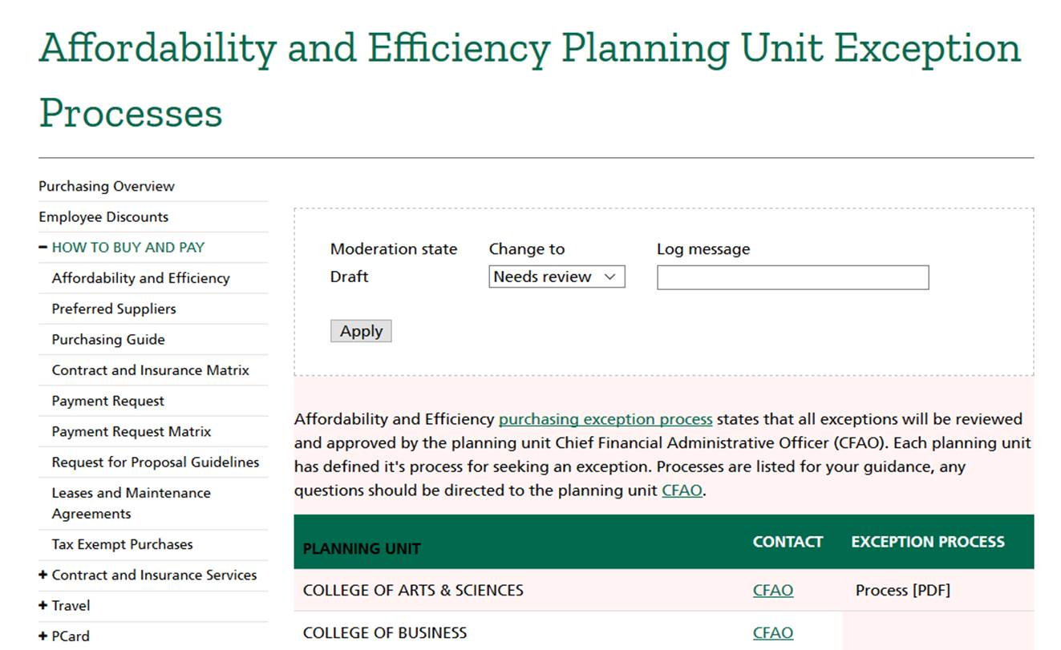
Purchasing Update
INSERT LINK

Slide 73
Questions?

