Slide 1
Benefits Advisory Council Update
For Faculty Senate
December 2022
FY24 – FY26 Benefits Projections
Benefits Changes for FY24
Health Plan Benchmarking

Slide 2
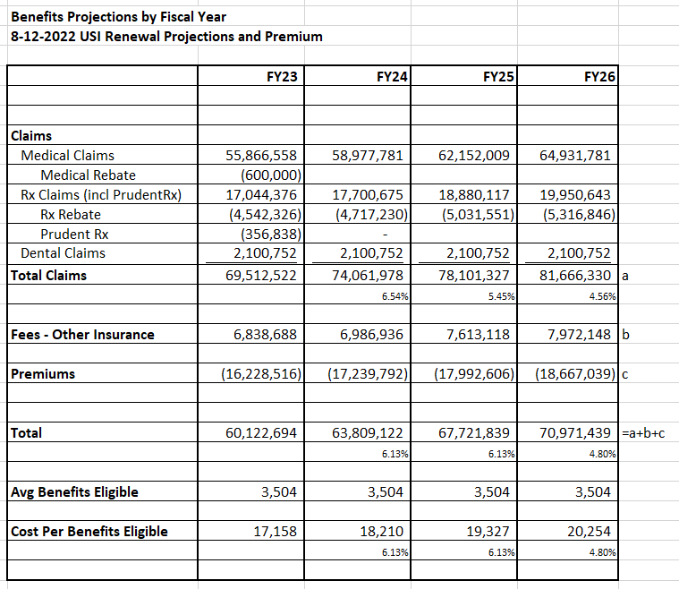
Benefits Budget and Expense Rate
FY24 – FY26 Projections will be updated in February 2023.
February projections are typically used to set benefits budget and premiums for the upcoming fiscal year.

Slide 3
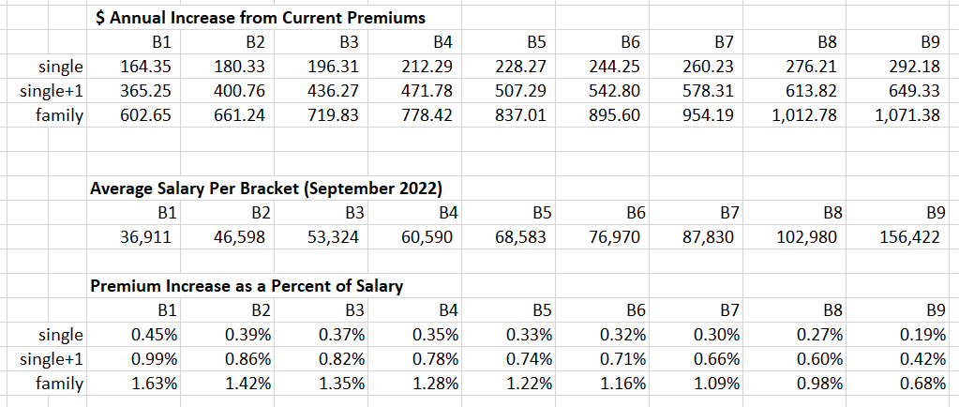
Benefits Budget – Projections Summary Information
Health plan premiums for the Faculty/Staff PPO plan are projected to rise by 12% for FY23
The annual increase and premiums and impact as a percent of pay is as follows:

Slide 4
BAC Update
Benefit Changes for FY24:
The BAC guiding principle/goal to cap the inflationary cost of benefits to the university at no more than 5% has been suspended for FY24.
FY24 Benefits costs are currently expected to rise by 6.13%*. Under the 5% cap/goal BAC would normally need to pursue plan design changes to contain costs. In the past a mix of changes to deductibles, out of pocket maximums, copays, prescription formularies, third party administrators, and the employee percent of premium paid were pursued to contain costs. (*The FY24 benefits budget will be re-projected in February 2023.)
Due to the suspension of the 5% goal/cap no changes to deductibles, out-of-pocket maximums, or copays are scheduled for FY24.
FY24 employee health care premiums will increase in proportion to the total. Employee premiums are set at a percent of the total premium. The current employee share of the total premium is 18% for single plans, 20% for single+1 plans, and 22% for family plans.

Slide 5
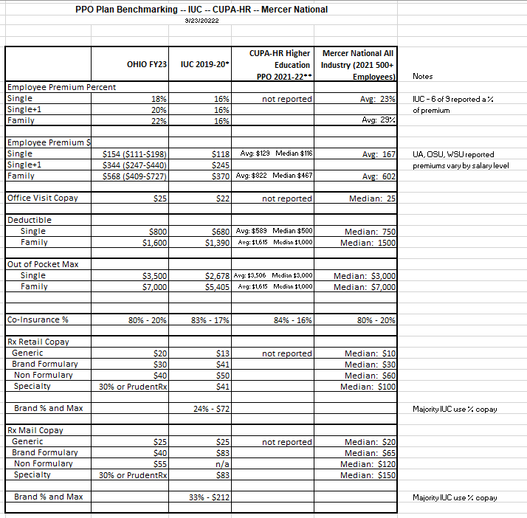
Benefits Benchmarking
Benchmarking to IUC, CUPA-HR, and Mercer National data reveals the university is at or above benchmark in most categories

