Slide 1
What is Community-engaged Research?
Making the Connection

Slide 2
ohio.edu/community-engaged-research
Why Community Engagement & Community-Engaged Research?
Ohio University President Nellis has articulated four key pathways and strategic priorities:
Become a national leader for diversity & inclusion
Enhance the overall academic quality of the university
Build a university engagement ecosystem
Become a place where dialogue & rigorous civil debate are institutional hallmarks

Slide 3
ohio.edu/community-engaged-research
Identify a common Community-Engaged Research (CER) definition
ANSWERING THE CALL:
Community-Engaged Research Advisory Board
Open 2-way communication by assessing needs, interests & challenges surrounding CER in the community & university
Address communication challenges
Foster collaboration through research funding & training

Slide 4
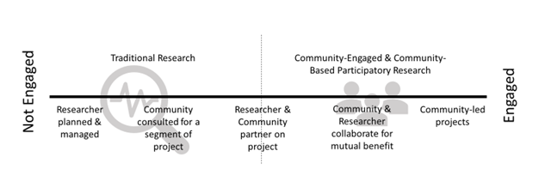
ohio.edu/community-engaged-research
Defining Community-Engaged Research

Slide 5
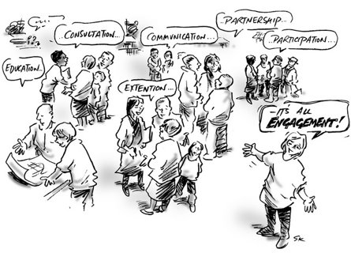
ohio.edu/community-engaged-research
Community-Engaged Research
Community-engaged research is a process where research is conducted WITH the community to ensure mutually beneficial outcomes.
Members of the research team are all equal partners throughout the research process. This is different than community-focused research where research is done ON or IN the community.

Slide 6
ohio.edu/community-engaged-research
Defining Our Community
Community is any small or large social unit that has something in common.
A Community may be based on geography, culture, religion, or identity.
Community partners may include, but are not limited to:
individuals and families;
school systems;
community coalitions;
neighborhood associations;
healthcare systems;
non-profits;
businesses and industry; and
government agencies

Slide 7
ohio.edu/community-engaged-research
Principles of Community Engagement

Slide 8
ohio.edu/community-engaged-research
Comparing Research Approaches
Source: Research Institute (OCTRI) http://www.ohsu.edu/xd/research/centers-institutes/octri/collaboration/upload/Frequently_Asked_Questions_about_Community-Engaged_Research.pdf

Slide 9
ohio.edu/community-engaged-research
Comparing Research Approaches
Source: Research Institute (OCTRI) http://www.ohsu.edu/xd/research/centers-institutes/octri/collaboration/upload/Frequently_Asked_Questions_about_Community-Engaged_Research.pdf

Slide 10
ohio.edu/community-engaged-research
Skill transfer
Meet community needs
Increased visibility in community
Community buy-in
Reduce barriers
Move toward positive social change
Sustainable Relationships
Why Community-Engaged Research?

Slide 11
ohio.edu/community-engaged-research
Why Community-Engaged Research?
Skills Transfer
Meeting Community Needs
Increased Visibility and Community Buy-in
Reduced Barriers
Move Toward Positive Social Change
Sustainable Relationships

Slide 12
ohio.edu/community-engaged-research
OHIO’s Commitment to Increasing Community-Engaged Research
Value of Building Community & University Relationships
Understanding the Components for Relationship Building
Strengthening Community & University Partnerships
Avoiding the Pitfalls that Undermine the Relationship

Slide 13
ohio.edu/community-engaged-research
Community-Engaged Research Resources
CER Training
Community-Engaged Research CITI Training – Open to all OU faculty, staff, students and all community partners
CER Networking
Community-based networking event for community and university members to connect and start working together
CER Website
www.ohio.edu/community-engage-research

Slide 14
ohio.edu/community-engaged-research
Tips for Building the Partnership
Set clear expectations
Mutual trust, respect and commitment
Identify strengths and needs
Clear and open communication
Have transparency in decision-making
Use feedback to, among and from all members
Have clear structure to define roles, norms, and processes
Use existing structures to incorporate in solutions
Strive to build a long-standing and sustainable partnership

Slide 15
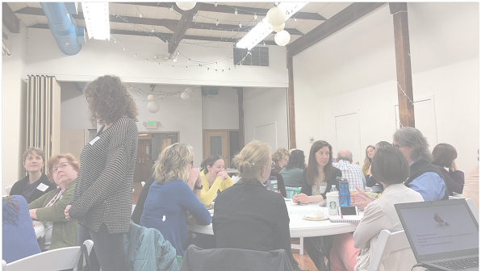
Community-Engaged Research Scenarios: Let’s Discuss…

Slide 16
ohio.edu/community-engaged-research
SCENARIO 1: Is this community-engaged research?
You have identified a funding stream that requires a community-based advisory board.
There is an established advisory board that could be beneficial as a partner on the grant application.
You talk to one member of the board and they seem interested.
For the grant, you reference this board as a partner but none of the board members are contributing to the project development because the grant deadline is very short.
Would this be considered community-engaged research?
No, this is not community-engaged research. Simply, referencing a community advisory board does not meet the criteria.

Slide 17
ohio.edu/community-engaged-research
SCENARIO 2: Is this community-engaged research?
A community member meets a faculty member at the Farmers’ Market, and they discuss issues around town.
They set up standing meetings where they discuss these issues.
Over time, they develop a question that they felt could be answered.
As a result, a couple students work along with the community and faculty member to design a research project that could help improve the issues identified.
Would this be considered community-engaged research?
Yes, this is community-engaged research. Taking cues from and engaging the community partner through the entire process meets the criteria.

Slide 18
ohio.edu/community-engaged-research
SCENARIO 3: Is this community-engaged research?
A project that is being developed has been endorsed by the project advisors who are community leaders.
During the implementation phase of the project, the researcher maintains complete control, including data collection and analysis.
The project advisors are only passively involved but have interest in helping and translating the findings.
Would this be considered community-engaged research?
No, this is not community-engaged research. The partnership needs to be equal across the entire process. The project advisors should contribute to and help with all aspects.

Slide 19
ohio.edu/community-engaged-research
SCENARIO 4: Is this community-engaged research?
While working together on designing research questions, a community representative provides an alternative research questions that they feel would be better for the community.
The researcher hears the suggestion and works to modify the questions to answer the new research question.
Would this be considered community-engaged research?
Yes, this is community-engaged research. Giving the community member an equal voice can contribute to stronger and questions that have a greater impact.

Slide 20
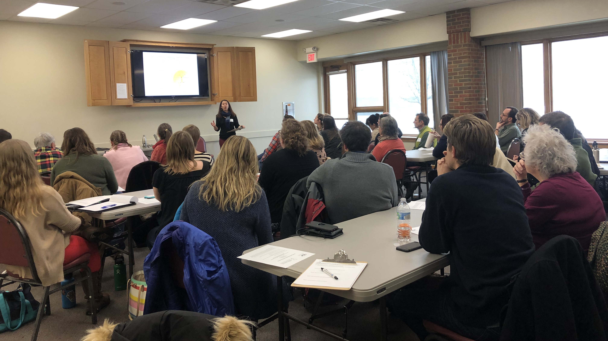
Stay Connected!
Email: CER@ohio.edu
Twitter: @bobcatsdiscover & @OHIOengagement
Web: ohio.edu/community-engaged-research

